Slide 1
Unit-II

Slide 2
Part 1

Slide 3
Graphs

Slide 4
Connected Graph
An undirected graph is said to be connected if there is a path between every pair of nodes. Otherwise, the graph is disconnected.
Disconnected
Connected

Slide 5
Connected Components
A connected component of a graph is a maximally connected subgraph of a graph.
If the graph is connected, then the whole graph is one single connected component

Slide 6
Graph Representation
Adjacency Matrix
Adjacency Lists
Linked Adjacency Lists
Array Adjacency Lists

Slide 7
Adjacency Matrix
1
2
3
4
5
2
1
0
1
0
1
0
3
2
1
0
0
0
1
1
3
0
0
0
0
1
4
4
1
0
0
0
1
5
5
0
1
1
1
0

Slide 8
Adjacency Matrix for weighted digraph
1
2
3
4
5
2
1
0
∞
∞
2
∞
4
3
2
4
0
∞
∞
8
1
8
3
∞
∞
0
∞
∞
7
2
4
4
∞
∞
∞
0
5
5
5
5
∞
8
7
∞
0

Slide 9
Adjacency Lists
Adjacency list for vertex i is a linear list of vertices adjacent from vertex i.
aList[1] = (2,4)
aList[2] = (1,5)
aList[3] = (5)
aList[4] = (5,1)
aList[5] = (2,4,3)
2
3
1
4
5

Slide 10
Linked Adjacency Lists
Each adjacency list is a chain.
2
aList[1]
2
4
3
[2]
1
5
1
[3]
5
[4]
5
1
4
aList[5]
2
4
3
5
Notes:
Array length n simply means we need an array with n spots. A direct implementation using a Java array would need n+1 spots, because spot 0 would not be utilized. However, by using spot 0 for vertex 1, spot 1 for vertex 2, and so on, we could get by with a Java array whose length is actually n.

Slide 11
Array Adjacency Lists
Each adjacency list is an array list.
2
aList[1]
2
4
3
[2]
1
5
1
[3]
5
[4]
5
1
4
aList[5]
2
4
3
5
int aList[ ][ ] = new int[5][ ];
aList[0] = new int[2];
aList[1] = new int[2];
aList[2] = new int[1];
aList[3] = new int[2];
aList[4] = new int[3];

Slide 12
Graph Traversal Techniques
The previous connectivity problem, as well as many other graph problems, can be solved using graph traversal techniques.
There are two standard graph traversal techniques:
Breadth-First Search (BFS)
Depth-First Search (DFS)

Slide 13
Depth First Search (DFS)

Slide 14
Depth-First Search
1.Start at a vertex v and mark it as reached (visited).
2.The exploration of a vertex v is suspended as soon as new vertex is reached. At this time the exploration of new vertex u begins .
3.When this new vertex has been explored, the exploration of v continues.
4. The search terminates when all reached vertices have been fully explored.
5.This process can be best described by using recursive algorithm.

Slide 15
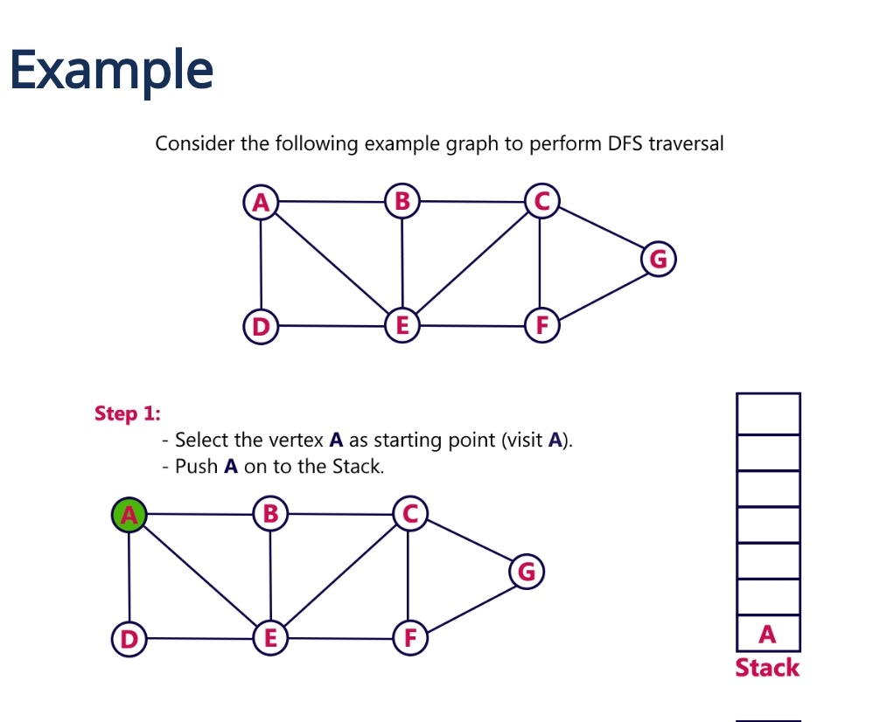

Slide 16
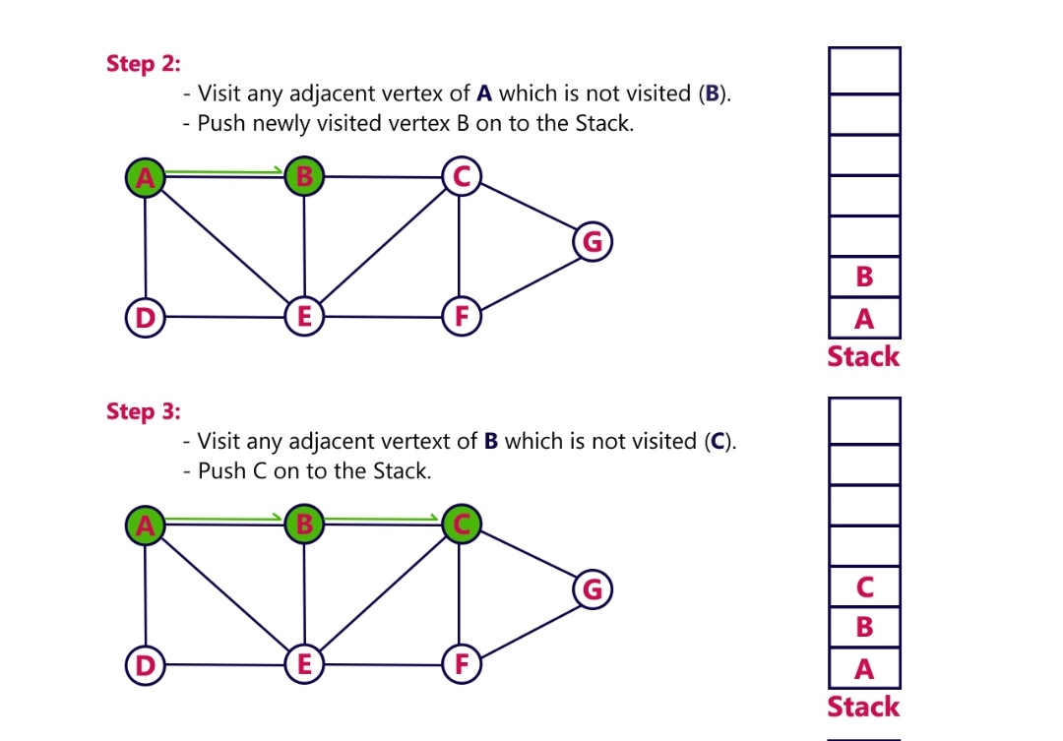

Slide 17
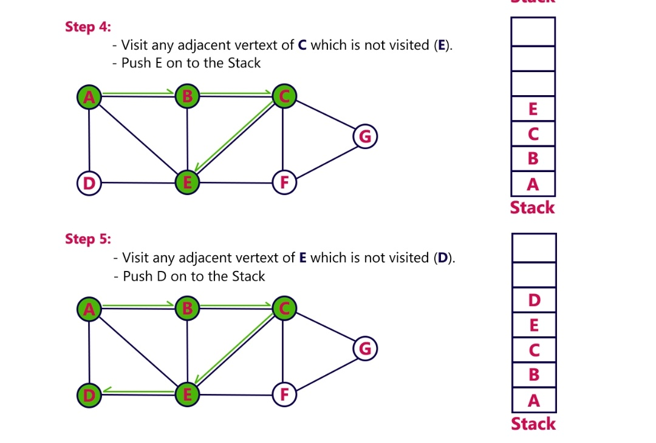

Slide 18
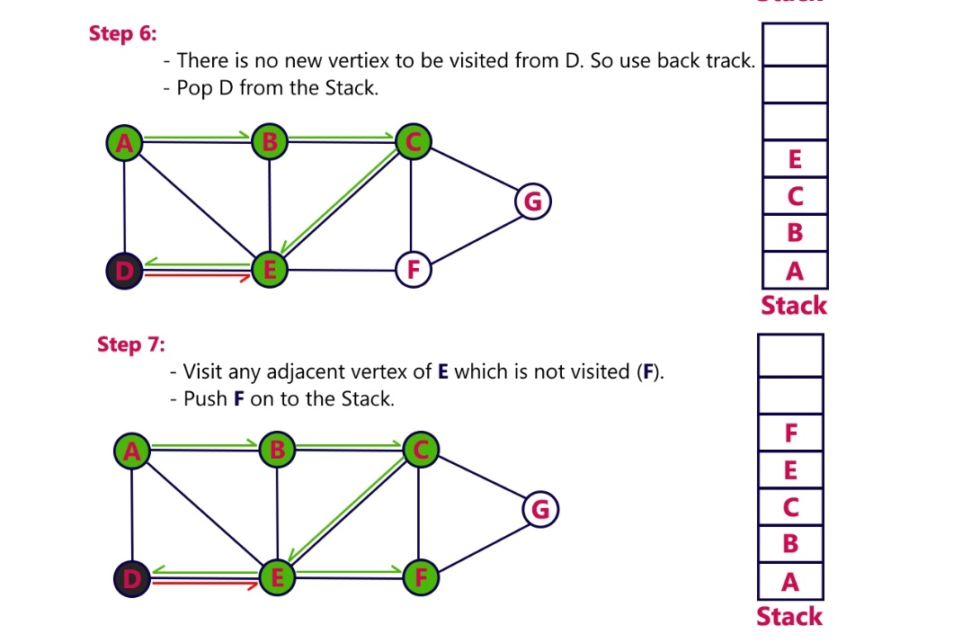

Slide 19
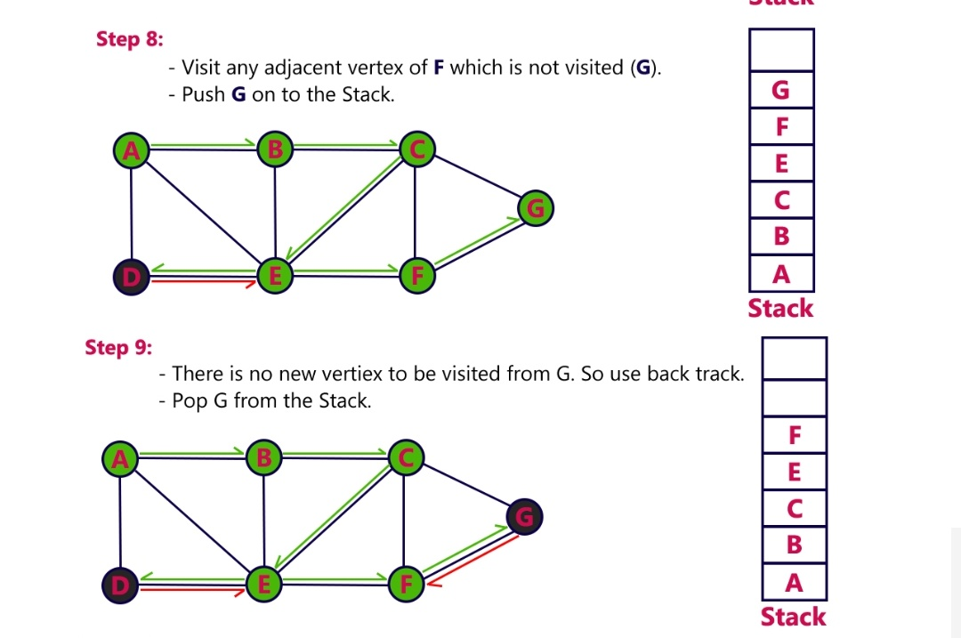

Slide 20
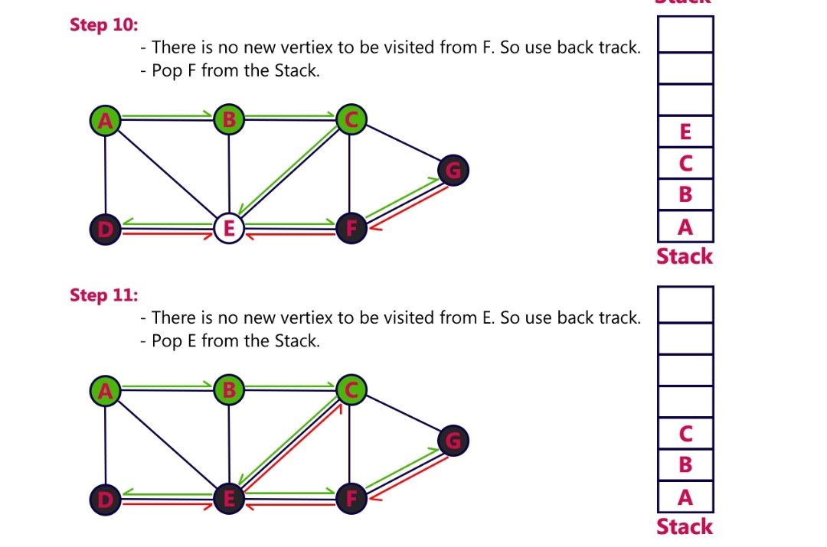

Slide 21
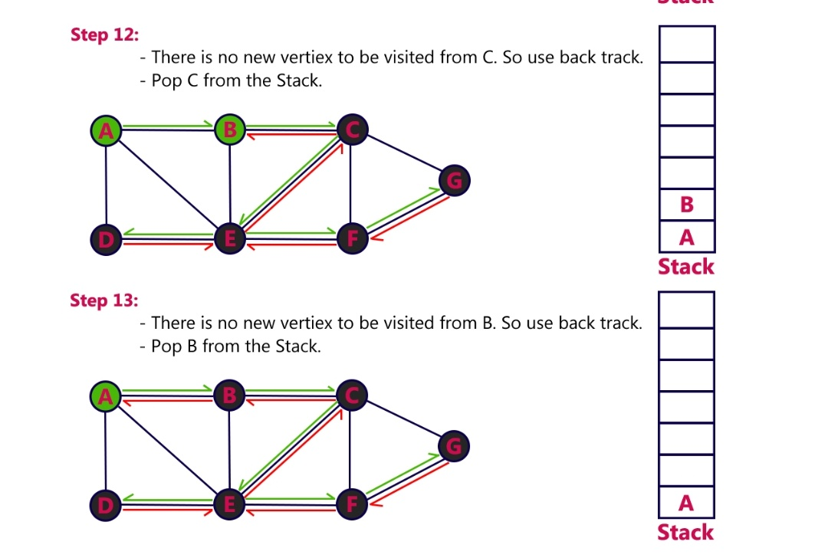

Slide 22
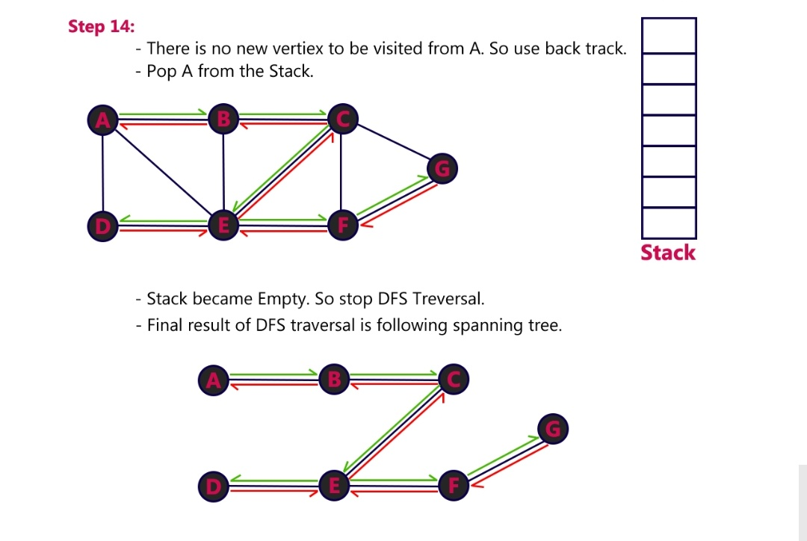

Slide 23
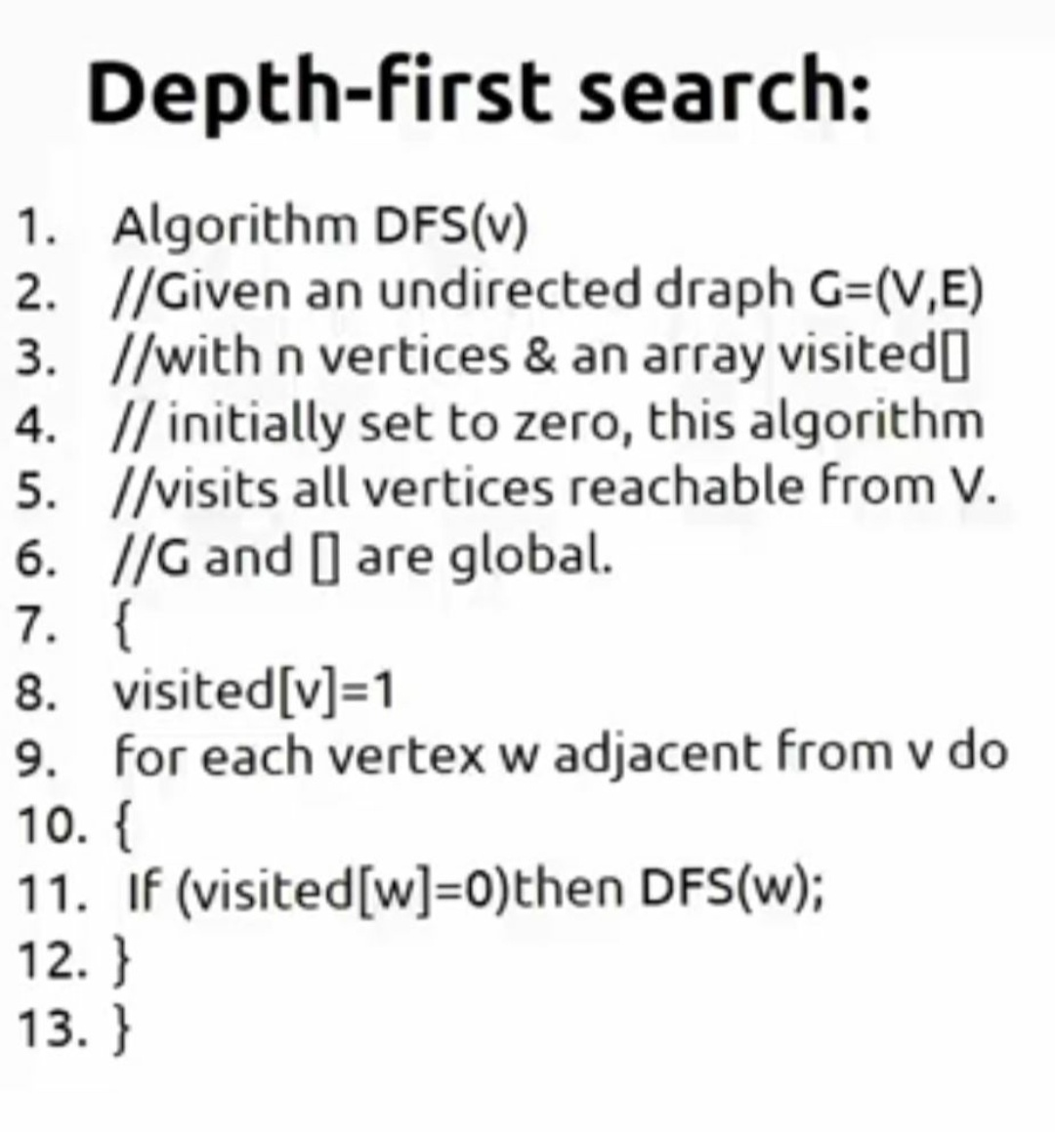

Slide 24
Breadth First Search (BFS)

Slide 25
Breadth-First Search
BFS follows the following rules:
1. Start at a vertex v and mark it as reached (visited).
2. The vertex v at this time is said to be unexplored.
3. A vertex is said to be explored when we visit all vertices adjacent from it.
4. All unvisited vertices adjacent from v are visited next.
These are new unexplored vertices.
5. The newly visited vertices haven’t been explored, put onto the end of a list of unexplored vertices. The first vertex on this list is the next to be explored.
6. The exploration continues until no unexplored vertex is left.

Slide 26
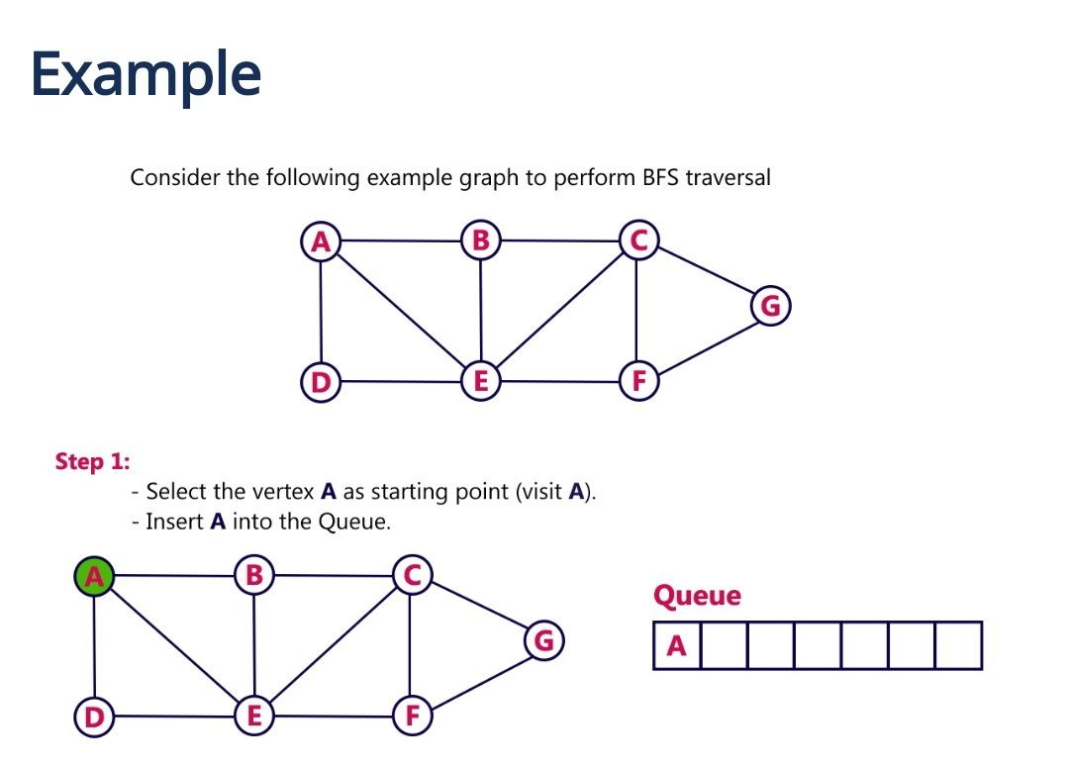

Slide 27
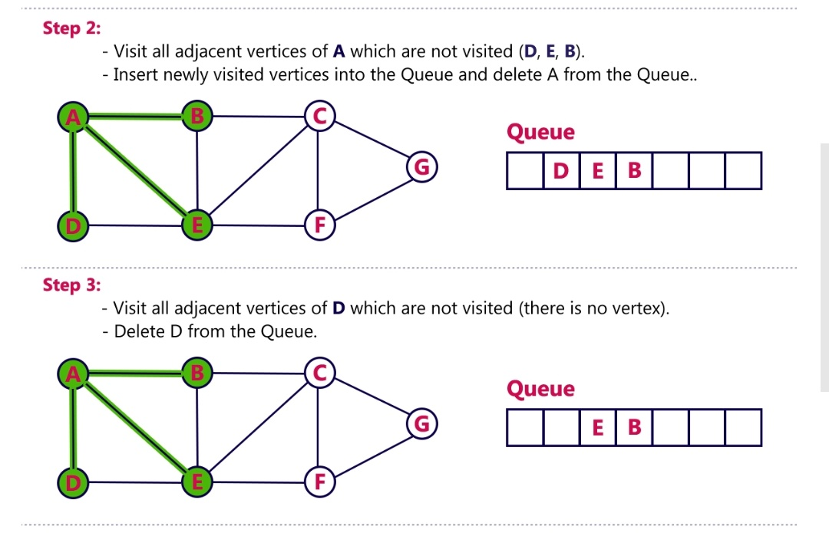

Slide 28
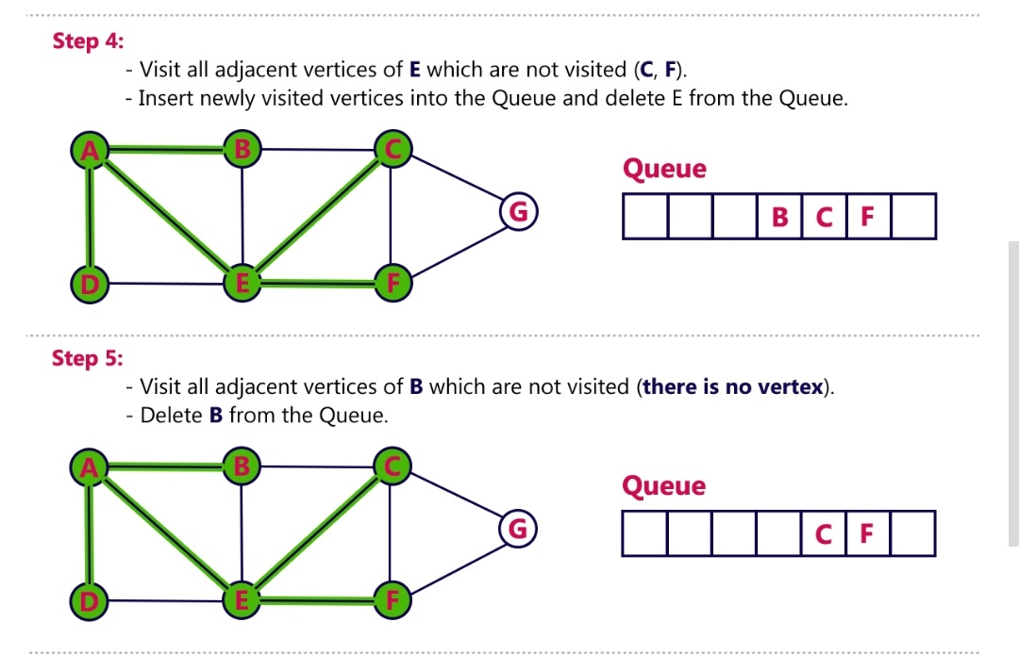

Slide 29
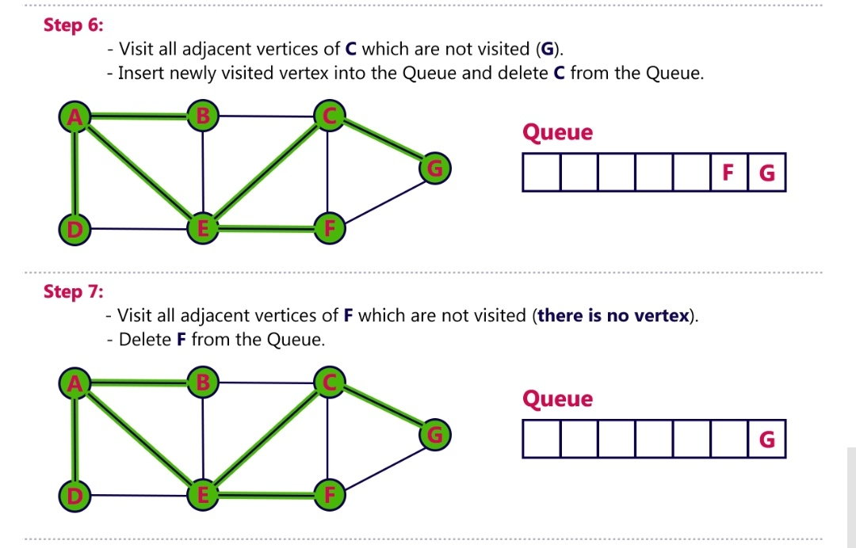

Slide 30
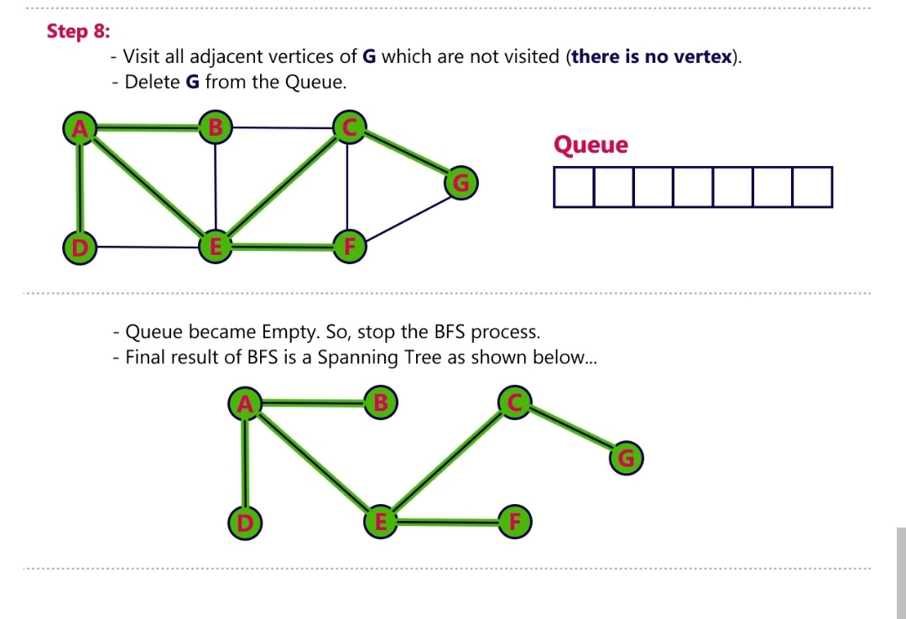

Slide 31
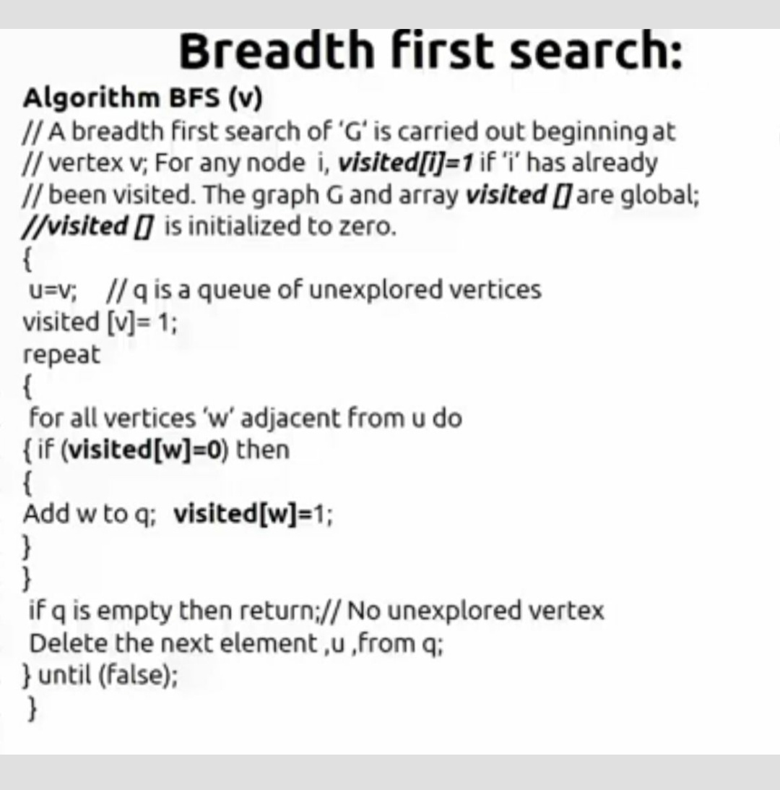

Slide 32
Ex:-
1
2
1
3
4
2
3
4
9
7
5
9
10
10
5
11
8
6
6
7
8
11
Graph G
BFS Tree

Slide 33
Time Complexity of BFS Algorithm
If G is represented by adjacency matrix, then
T( n,e)=O( n² )
If G is represented by adjacency lists, then
T( n,e)=O( n+e )
Where,
n is number nodes.
e is number of edges.

Slide 34
Ex:-
1
2
1
2
4
3
3
5
9
9
4
7
7
11
10
5
6
11
8
10
8
6
DFS Tree
Graph G

Slide 35
Time Complexity of DFS Algorithm:-
If G is represented by adjacency matrix, then
T( n,e)=O( n² )
If G is represented by adjacency lists, then
T( n,e)=O( n+e )
Where,
n is number nodes.
e is number of edges.

Slide 36
Strongly-Connected Graph
Graph G is strongly connected if, for every u and v, there is some path from u to v and some path from v to u.
Not Strongly Connected
Strongly Connected
A
B
A
B
C
C
E
E
D
D

Slide 37
Strongly-Connected Components
A strongly connected component of a graph is a maximally connected subgraph of graph.

Slide 38
Strongly Connected Components
a
{ a , c , g }
g
c
d
{ f , d , e , b }
e
f
b

Slide 39
Bi-connected graph
Problem:
If any one vertex (and the edges connected to it) are removed from a connected graph.
is the remaining subgraph still connected?
Biconnected graph:
A connected undirected graph G is said to be biconnected if it remains connected after removal of any one vertex and the edges that are connected to that vertex.

Slide 40
Biconnected
Not Biconnected

Slide 41
Biconnected Component
A biconnected component of a undirected graph is a maximally connected biconnected subgraph of a graph.
Biconnected Components

Slide 42
Articulation point:
A vertex v in a connected graph G is an articulation point if and only if the deletion of vertex v together with all edges connected to v disconnects the graph into two more nonempty components.

Slide 43
Graph G
6
5
1
2
7
4
8
3
10
9
Nodes 2, 3 and 5 are articulation points.

Slide 44
Identifying articulation points
Step 1 : Construct a Depth First Search Tree of G and assign Depth First Numbers (dfn) to each vertex in the Tree.
Step 2: Identify what are the back edges in the Tree.
Step 3: Observations to be done.
Step 4: Find the low values to each vertex.
Step 5: Finding an Articulation Point.

Slide 45
Step 1
1
1
6
2
4
5
1
3
3
2
7
4
6
8
4
10
2
3
9
5
5
10
9
7
9
6
7
8
Fig b
Fig a
8
10

Slide 46
DFS
Step 2
6
8
1
1
5
7
6
2
4
2
7
9
3
3
8
10
Back Edges : 2-1, 7-2, 8-2, 8-5
10
9
4
5

Slide 47
Step 3:-
The root node of a DFS tree is an articulation point iff it
has at least two children.
A leaf node of DFS tree is not an articulation point.
If u is any internal node, then it is not an articulation
point iff from every child w of u, if it is possible to reach
an ancestor of u using only a path made up of descendants( 0 or more number descendants)
of w and a back edge.
1, 2, 3, 4, 5, 6, 7, 8, 9, 10

Slide 48
L[u] = min{ dfn[u], min{ L[w] l w is a child of u }, min{ dfn[w] l (u,w) is a back edge}}
L[1] = min{ dfn[1], min{L[4]}, min{-} } = min{1, L[4], -} = 1
L[2] = min{ dfn[2], min{L[5]}, min{dfn[1]} } = min{6, L[5], 1} = min{6,6,1} = 1
L[3] = min{ dfn[3], min{L[10], L[9], L[2]}, min{-} } = min{3, 1, -} = 1
L[4] = min{ dfn[4], min{L[3]}, min{-} } = min{6, L[5], 1} = min{2, 1, -} = 1
L[5] = min{ dfn[5], min{L[6], L[7]}, min{-} } = min{7, 6 , -} = 6
L[6] = min{ dfn[6], min{-}, min{-} } = min{8, -, -} = 8
L[7] = min{ dfn[7], min{L[18]}, min{dfn[2]} } = min{9, 6, 6} = 6
L[8] = min{ dfn[8], min{-}, min{dfn[2], dfn[5]} } = min{10, -, min{6,7} } =
min{ 10, -, 6} = 6
L[9] = min{ dfn[9], min{-}, min{-} } = min{5, -, -} = 5
L[10] = min{ dfn[10], min{-}, min{-} } = min{4, -, -} = 4

Slide 49
Step-5 : ‘u’ is an articulation point if u has a child ‘w’ such that: L[w] >=dfn[u]
u = 2, 3, 4, 5, 7 ( 2, 3, 5 Articulation Points)
U=2, w=5
L[w]>=dfn[u]
L[5]>=dfn[2]
6>=6 ( 2 is an articulation point)
U=3, w=10,9,2
L[w]>=dfn[u]
L[10]>=dfn[3]
4>=3 ( 3 is an articulation point)
L[9]>=dfn[3]
5>=3 ( 3 is an articulation point)
L[2]>=dfn[3]
1>=3
U=4, w=3
L[w]>=dfn[u]
L[3]>=dfn[4]
1>=2 ( 4 is not an articulation point)
U=5, w=6,7
L[w]>=dfn[u]
L[6]>=dfn[5]
8>=7 ( 5 is an articulation point)
L[7]>=dfn[5]
6>=7
U=7, w=8
L[w]>=dfn[u]
L[8]>=dfn[7]
6>=9 ( 7 is not an articulation point)

Slide 50
Biconnected components of graph G
1
6
2
4
5
3
5
3
3
7
2
8
10
9

Slide 51
Part - 2

Slide 52
Greedy Method
Greedy algorithm obtains an optimal solution by making a sequence of decisions.
Decisions are made one by one in some order.
Each decision is made using a greedy-choice property or greedy criterion.
A decision, once made, is (usually) not changed later.

Slide 53
A greedy algorithm always makes the decision that looks best at the moment.
It does not always produce an optimal solution.
It works best when applied to problems with the greedy-decision property.
A feasible solution is a solution that satisfies the constraints.
An optimal solution is a feasible solution that optimizes the objective function.

Slide 54
Greedy method control abstraction/ general method
Algorithm Greedy(a,n)
// a[1:n] contains the n inputs
{
solution= //Initialize solution
for i=1 to n do
{
x:=Select(a);
if Feasible(solution,x) then
solution=Union(solution,x)
}
return solution;
}

Slide 55
Applications
Job Sequencing with Deadlines
Knapsack Problem
Minimum cost Spanning Tree
Single Source Shortest Path
Optimal Storage on Tapes

Slide 56
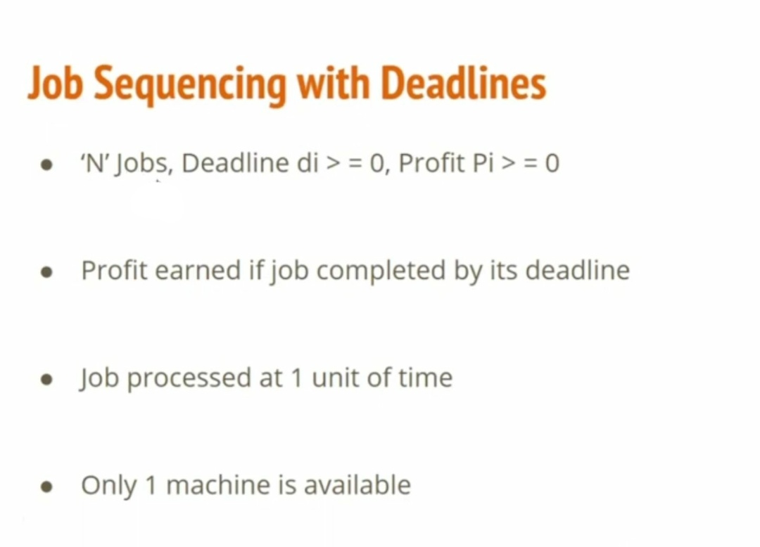

Slide 57
JOB SEQUENCING WITH DEADLINES
The problem is stated as below.
There are n jobs to be processed on a machine.
Each job i has a deadline d_{i}≥ 0 and profit p_{i}≥0 .
Pi is earned iff the job is completed by its deadline.
The job is completed if it is processed on a machine for unit time.
Only one machine is available for processing jobs.
Only one job is processed at a time on the machine.

Slide 58
JOB SEQUENCING WITH DEADLINES (Contd..)
A feasible solution is a subset of jobs J such that each job is completed by its deadline.
An optimal solution is a feasible solution with maximum profit value.
Example : Let n = 4, (p₁,p₂,p₃,p₄) = (100,10,15,27),
(d₁,d₂,d₃,d₄) = (2,1,2,1)

Slide 59
GREEDY ALGORITHM TO OBTAIN AN OPTIMAL SOLUTION
Consider the jobs in the non increasing order of profits subject to the constraint that the resulting job sequence J is a feasible solution.
In the example considered before, the non-increasing profit vector is
(100 27 15 10) (2 1 2 1)
p₁ p₄ p₃ p₂ d₁ d₄ d₃ d₂

Slide 60
JOB SEQUENCING WITH DEADLINES (Contd..)
Stage :1 (n=1) Stage :2 (n=2)
J1
J2
J1
0
1
2
0
1
2
J2
J1
J3
or
J3
J1
0
1
2
0
1
2
0
1
2
J3
J4
J1
0
1
2
0
1
2
J4
J2
J3
J4
J3
0
1
2
0
1
2
0
1
2

Slide 61
JOB SEQUENCING WITH DEADLINES (Contd..)
S.No. Feasible Processing Profit value
Solution Sequence
1 (1,2) (2,1) 110
2 (1,3) (1,3) or (3,1) 115
3 (1,4) (4,1) 127 is the optimal one
4 (2,3) (2,3) 25
5 (3,4) (4,3) 42
6 (1) (1) 100
7 (2) (2) 10
8 (3) (3) 15
9 (4) (4) 27

Slide 62
Let n = 5, (p₁,--------p₅) = (20,15,10,5,1) and (d₁,--d₅) = (2,2,1,3,3).
Jobs Assigned Slot Action Profit
{} None None 0
{1} [1,2] J1 is accepted 20
{1,2} [1,2][0,1] J2 is accepted 35
{1,2,3} [1,2][0,1] J3 is rejected -
{1,2,4} [0,1][1,2][2,3] J4 is accepted 40
Optimal Sequence is : {J2, J1, J4}
The optimal solution is {1,2,4}
J2
J1
J4
0
1
2
3

Slide 63
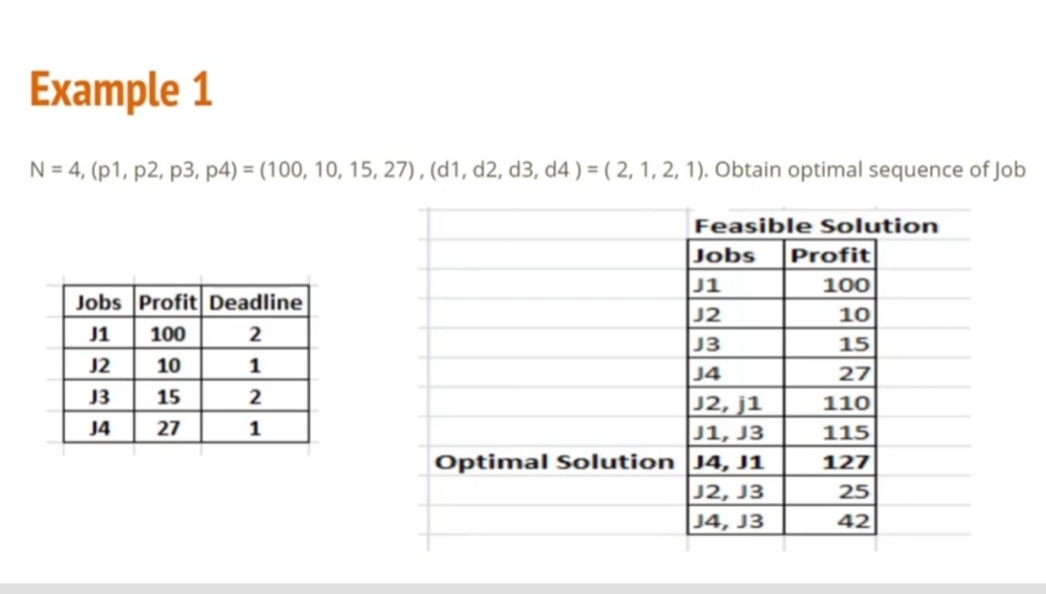

Slide 64
Algorithm JS(d,j,n)
//d[i]≥1, 1 ≤ i ≤ n are the deadlines.
//The jobs are ordered such that p[1] ≥p[2] …… ≥p[n]
// j[i] is the i^{th} job in the optimal solution, 1≤ i
{
d[0]=j[0]=0; // Initialize
j[1]=1; // Include job 1
k=1;

Slide 65
for i=2 to n do
{ //Consider jobs in Descending order of p[i].
// Find position for i and check feasibility of
// insertion.
r=k;
while( ( d[ j[r]]> d[i] and ( d[j[r]] ≠ r )) do
r= r-1;
if( d[i] > r )) then
{
// Insert i into j[].
for q=k to (r+1) step -1 do j[q+1] = j[q];
j[r+1] :=i;
k:=k+1;
}
}
return k;
}
Time taken by this algorithm is o(n²)

Slide 66
Knapsack Problem

Slide 67
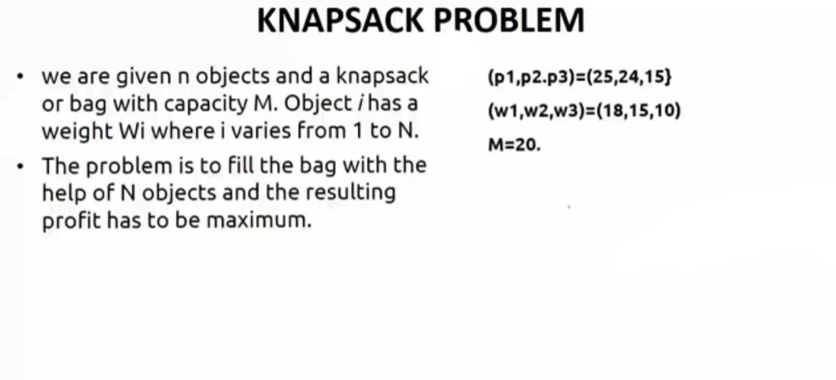

Slide 68
Maximize ∑ p_{i}x_{i}
Subject to ∑ w_{i}x_{i} ≤ m
0 ≤ x_{i} ≤ 1, 1 ≤i ≤n

Slide 69


Slide 70
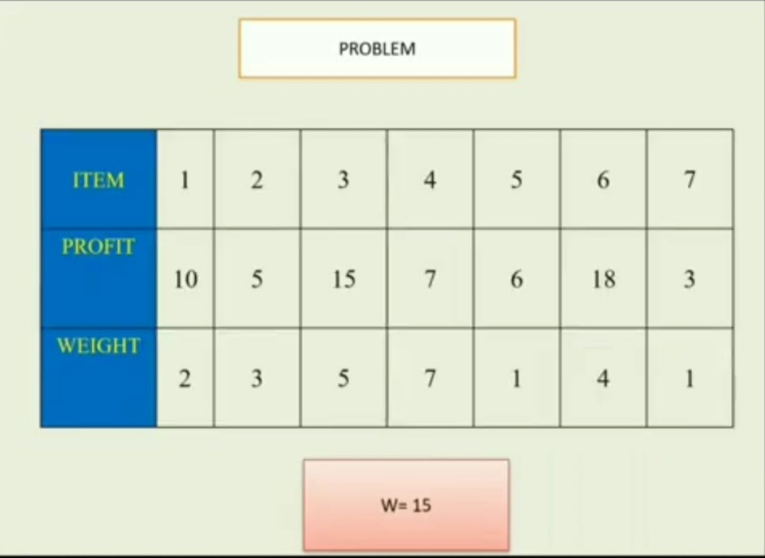

Slide 71
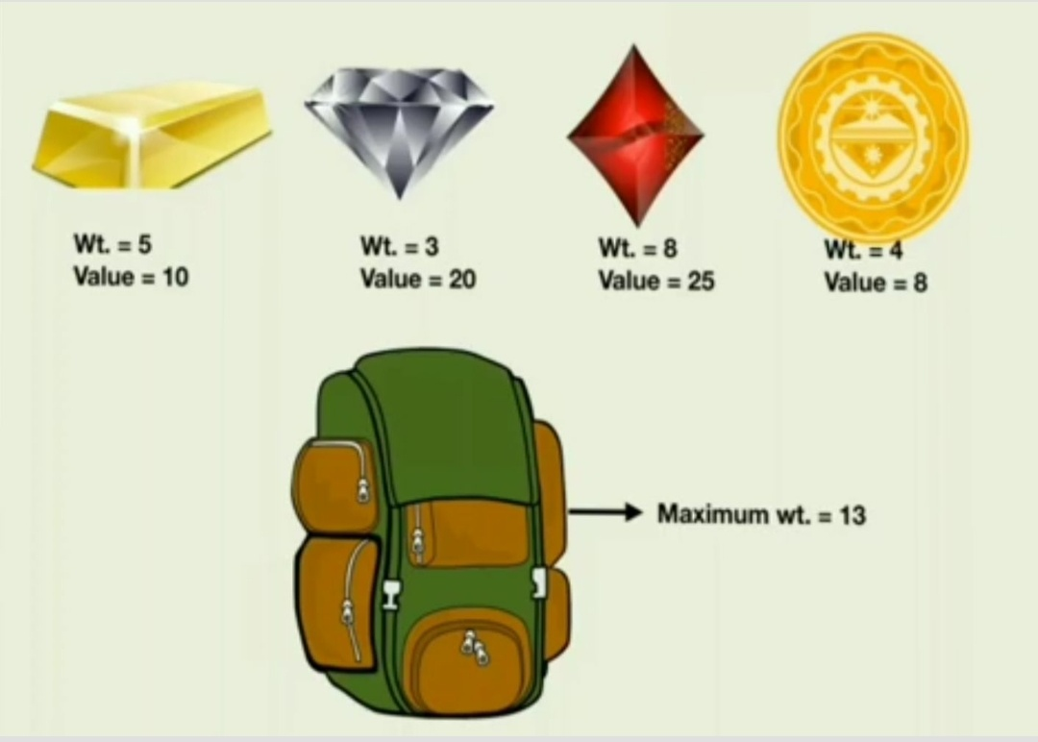

Slide 72
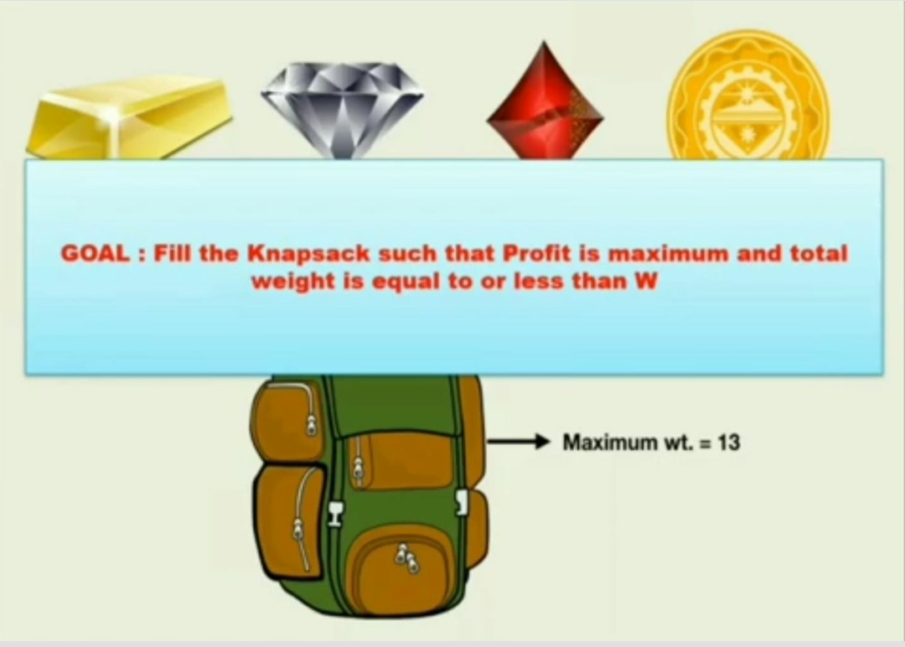

Slide 73
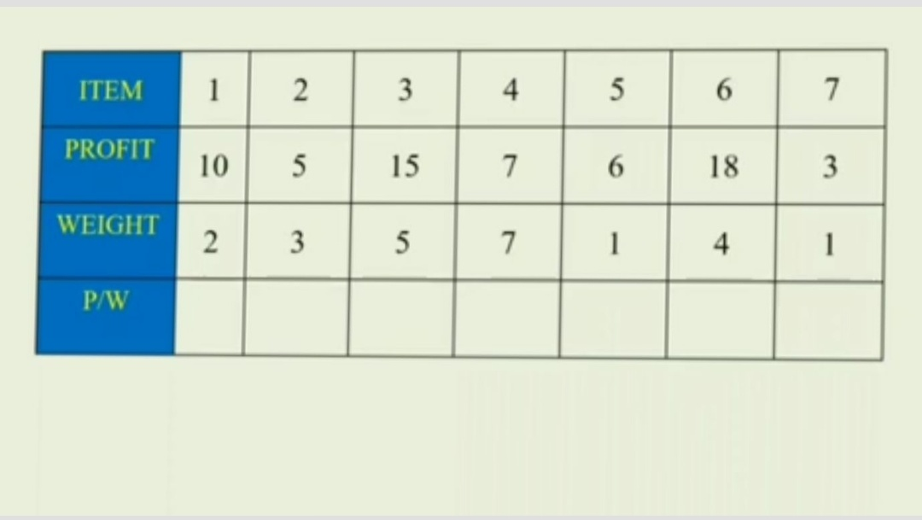

Slide 74
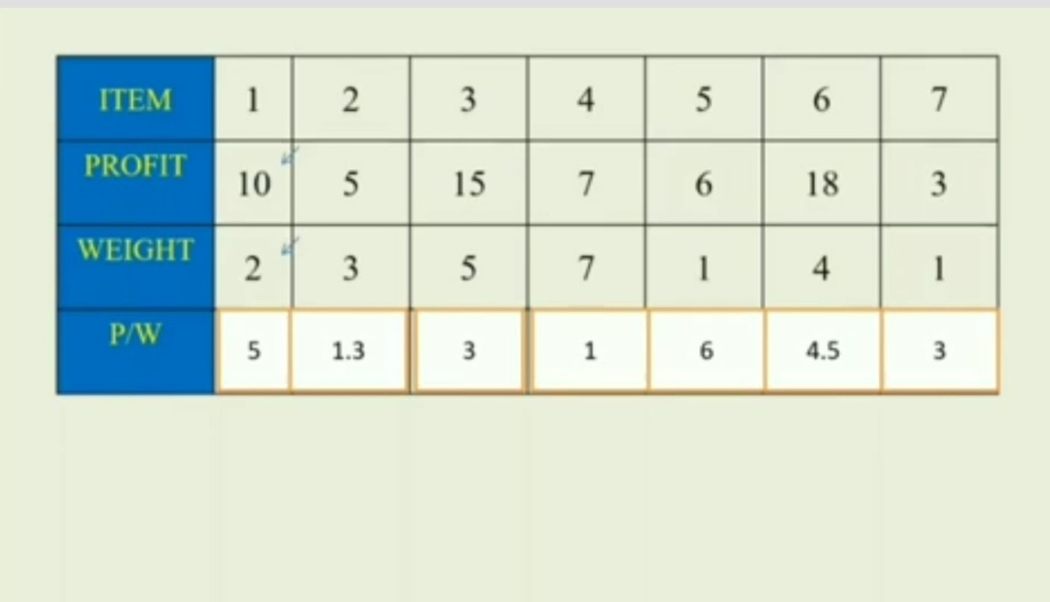
(x_{5,} x_{1,} x_{6,} x_{3,} x_{7,} x_{2,} x₄) = (0, 0, 0, 0, 0, 0, 0)

Slide 75
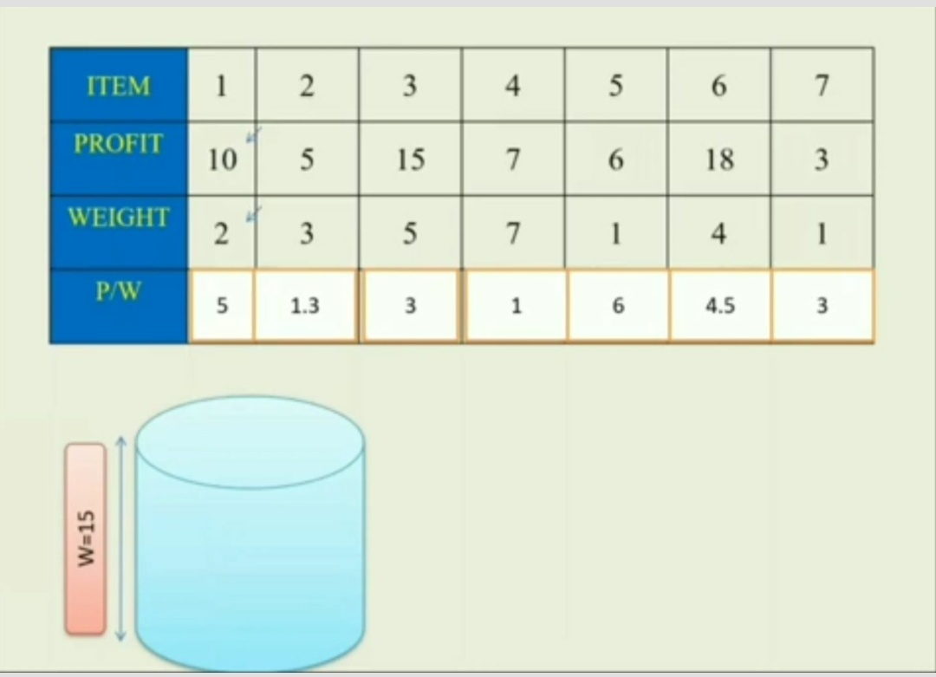

Slide 76
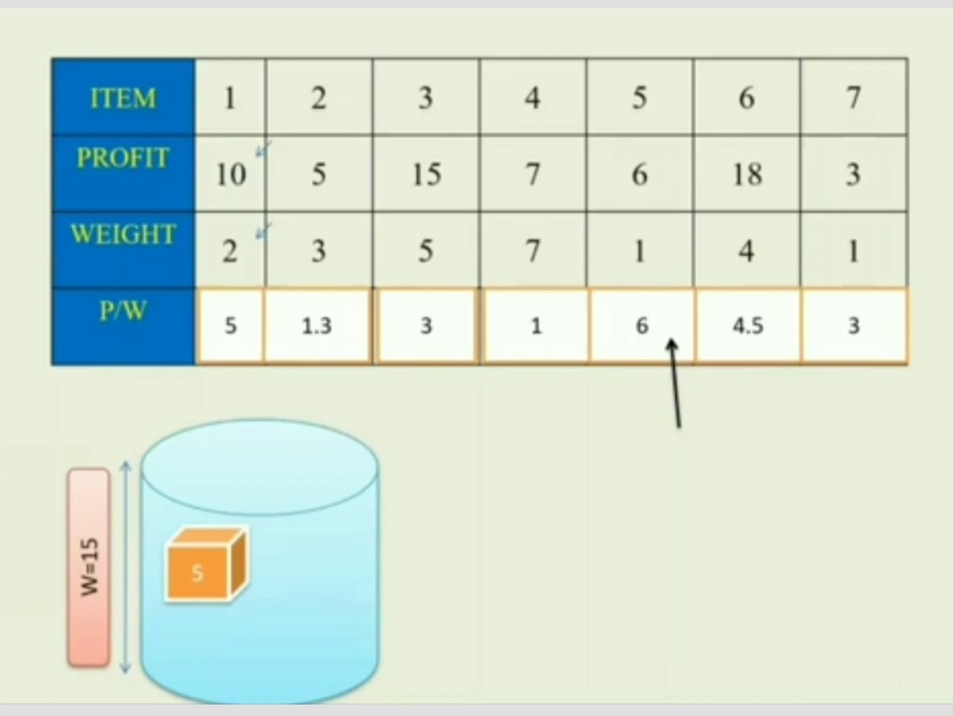
(x_{5,} x_{1,} x_{6,} x_{3,} x_{7,} x_{2,} x₄) = (1, 0, 0, 0, 0, 0, 0)

Slide 77
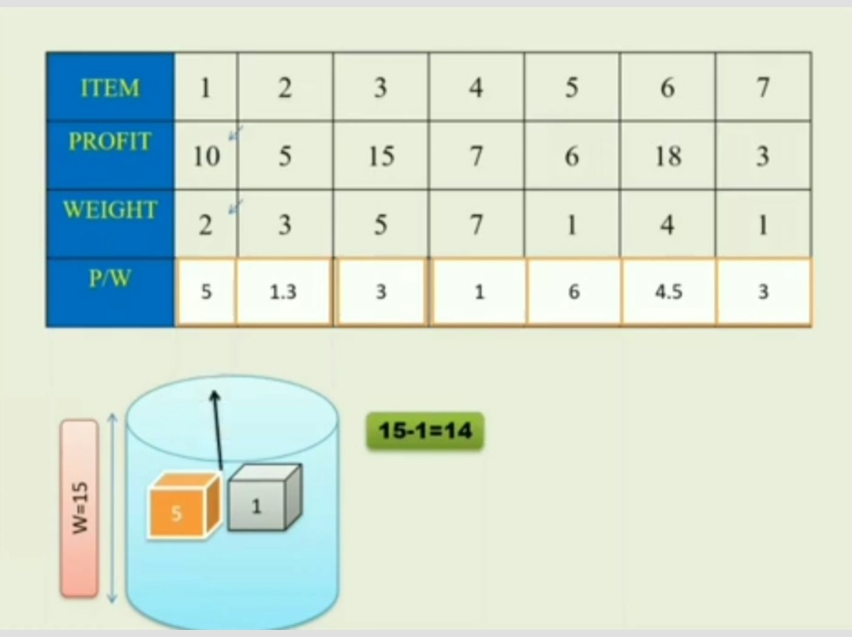

Slide 78
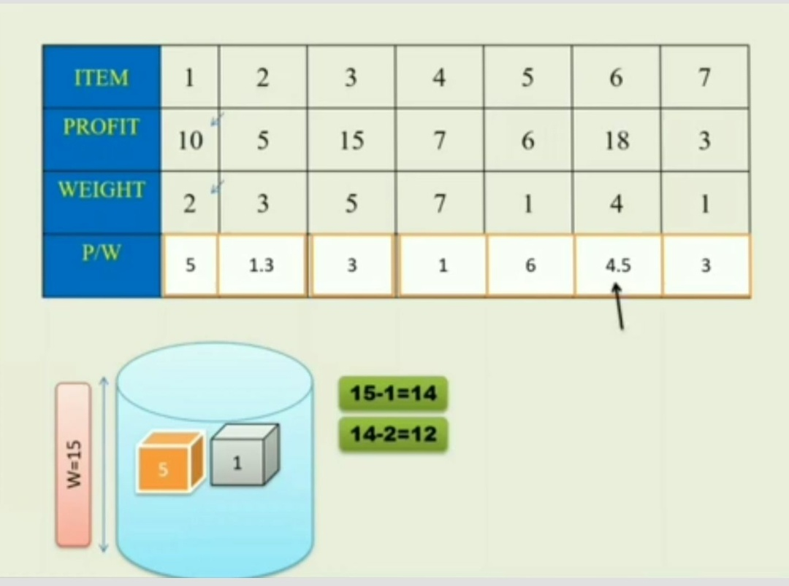
(x_{5,} x_{1,} x_{6,} x_{3,} x_{7,} x_{2,} x₄) = (1, 1, 0, 0, 0, 0, 0)

Slide 79
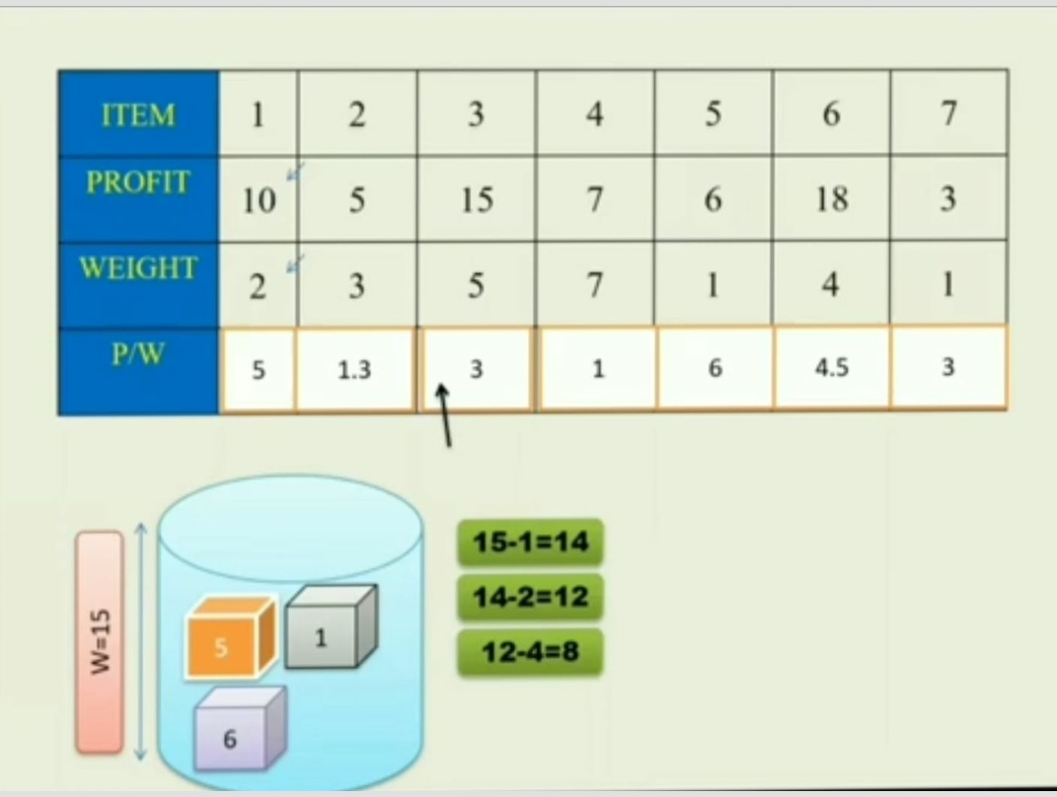
(x_{5,} x_{1,} x_{6,} x_{3,} x_{7,} x_{2,} x₄) = (1, 1, 1, 0, 0, 0, 0)

Slide 80
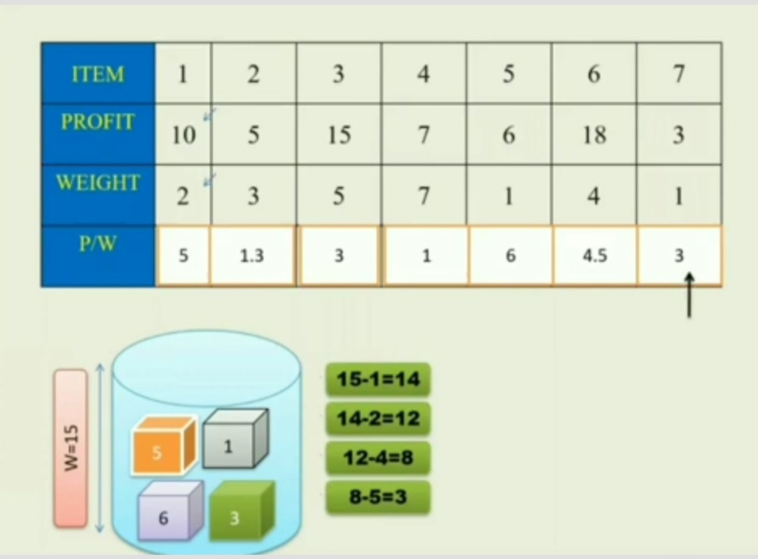
(x_{5,} x_{1,} x_{6,} x_{3,} x_{7,} x_{2,} x₄) = (1, 1, 1, 1, 0, 0, 0)

Slide 81
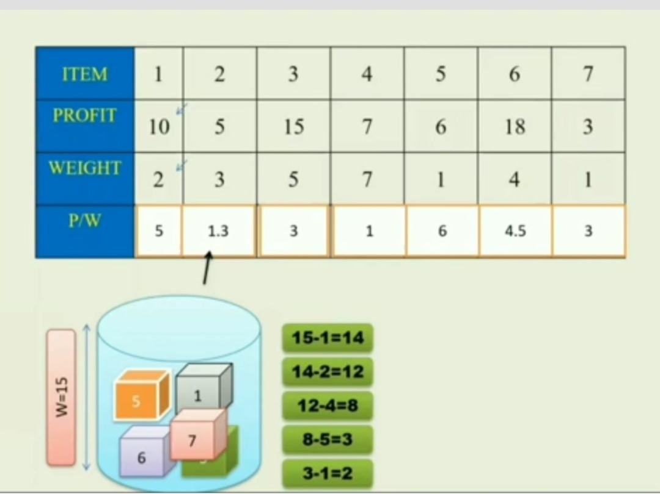
(x_{5,} x_{1,} x_{6,} x_{3,} x_{7,} x_{2,} x₄) = (1, 1, 1, 1, 1, 2/3, 0)

Slide 82
Profit = 1*6 + 1*10+ 1*18+ 1*3+ 1*15+ 2/3*5+
0*7 = 55.3

Slide 84
P_{1/}w₁ = 25/18 = 1.3
P_{2/}w₂ = 24/15 = 1.6
P_{3/}w₃ = 15/10 = 1.5
Profit = 1*24 + ½*15 = 24+7.5 = 31.5
(x_{2,} x_{3,} x₁) = (1, 1/2, 0)

Slide 85
Greedy algorithm for the fractional Knapsack problem
Algorithm GreedyKnapsack(m,n)
//P[1:n] and w[1:n] contain the profits and weights
// respectively of the n objects ordered such that
//p[i]/w[i]>=p[i+1]/w[i+1].
//m is the knapsack size and x[1:n] is the solution
// Vector.
{
for i=1 to n do x[i]=0; // Initialize x.
U=m;
for i=1 to n do
{
if ( w[i]>U ) then break;
if x[i]=1; U=U-w[i];
}
if ( i <=n) then x[i]= U/w[i];
}
If you do not consider the time to sort the items, then the time taken by the
above algorithm is O(n).

Slide 86
Spanning Tree
A tree is a connected undirected graph that contains no cycles.
A spanning tree of a graph G is a subgraph of G that is a tree and contains all the vertices of G.

Slide 87
Properties of a Spanning Tree
The spanning tree of a n-vertex undirected graph has exactly n – 1 edges.
It connects all the vertices in the graph.
A spanning tree has no cycles.

Slide 88
Ex:-
1
A
B
A
1
B
A
B
5
4
2
4
2
4
6
D
C
D
C
D
C
3
3
3
1
1
Undirected Graph
A
B
A
B
2
2
4
D
C
D
C
3
…
Some Spanning Trees

Slide 89
Minimum Cost Spanning Tree / Minimum Spanning Tree (MST)
A minimum spanning tree is the one among all the spanning trees with the smallest total cost.
1
1
A
B
A
B
4
2
4
2
5
D
C
D
C
3
3
Undirected Graph
Minimum Spanning Tree

Slide 90
Applications of MSTs
Computer Networks
To find how to connect a set of computers using the minimum amount of wire.

Slide 91
Minimum Cost Spanning Tree
Prim’s Algorithm
Kruskal’s Algorithm

Slide 92
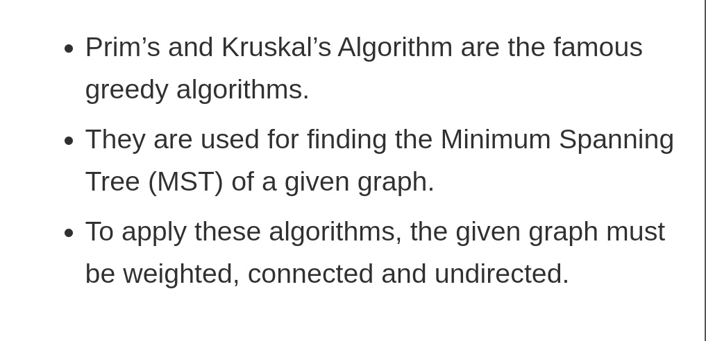

Slide 93
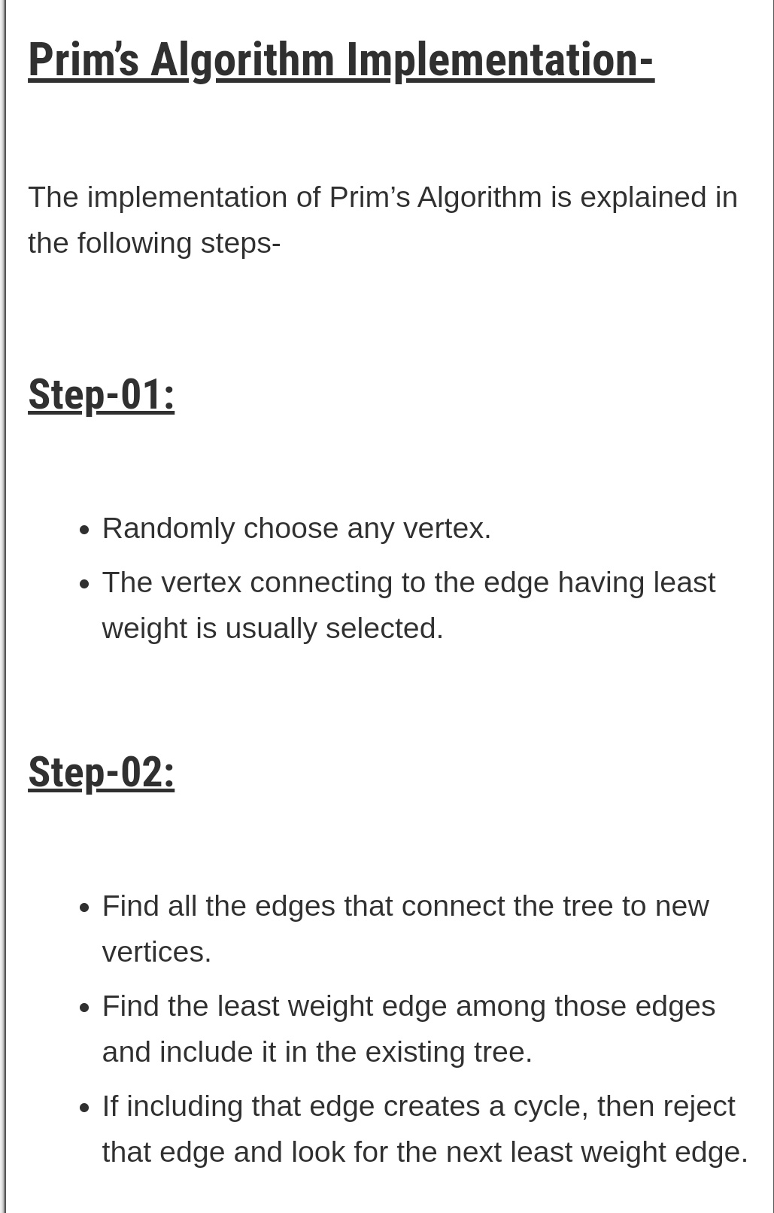

Slide 94
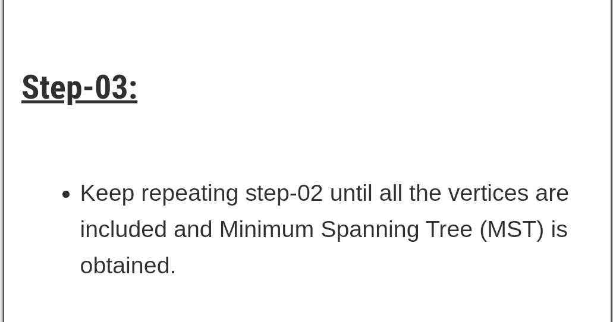

Slide 95
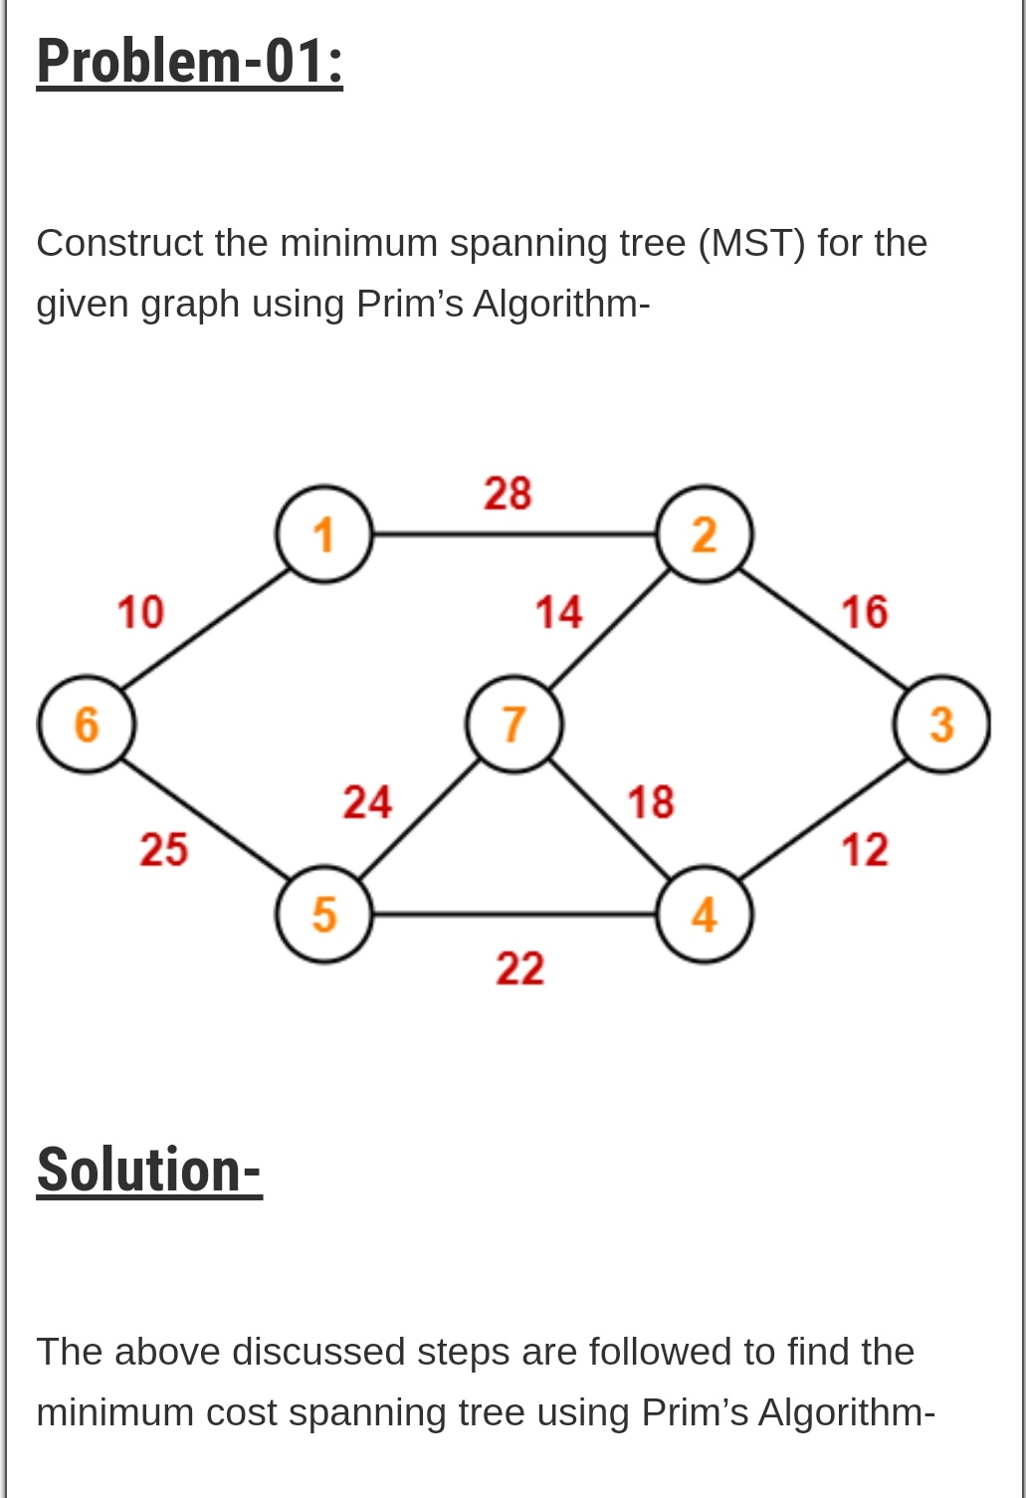

Slide 96
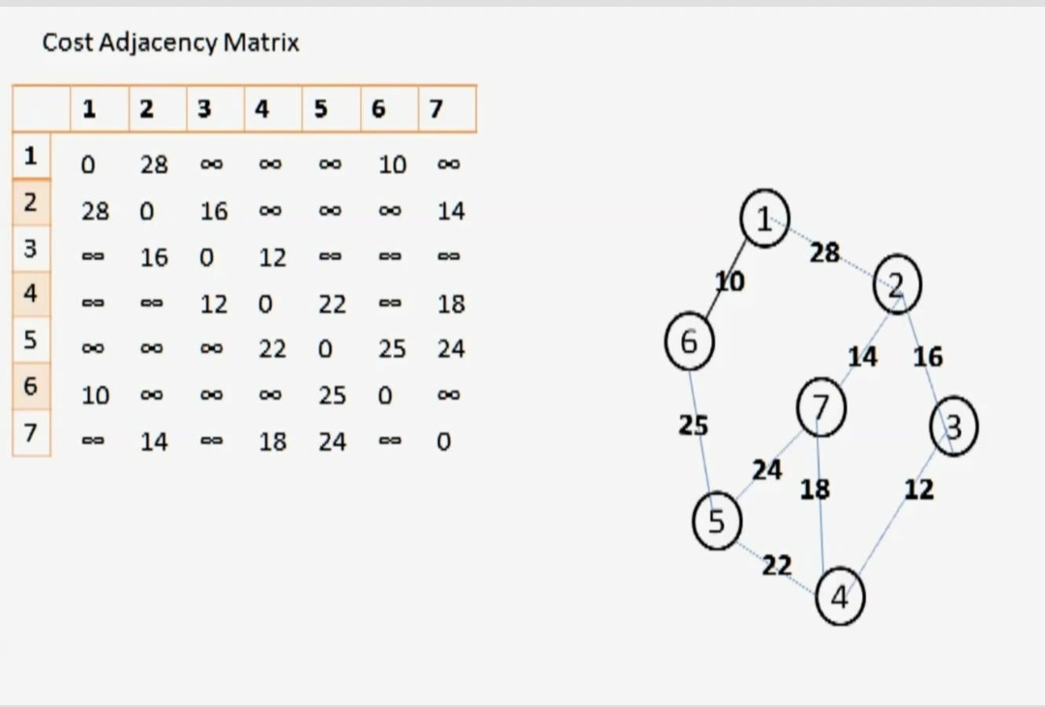

Slide 97
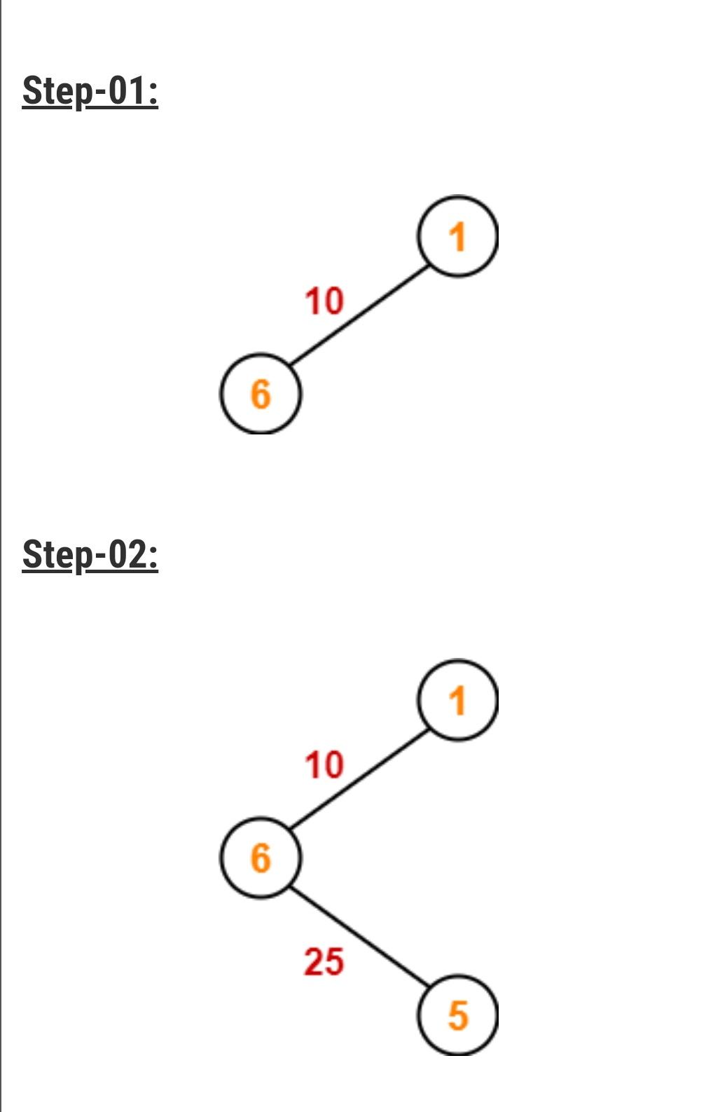

Slide 98
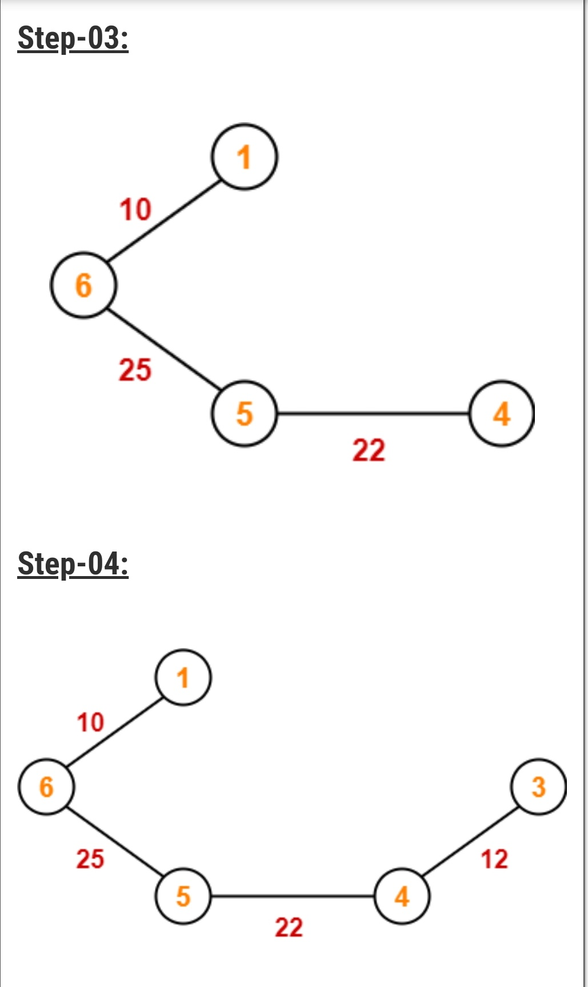

Slide 99
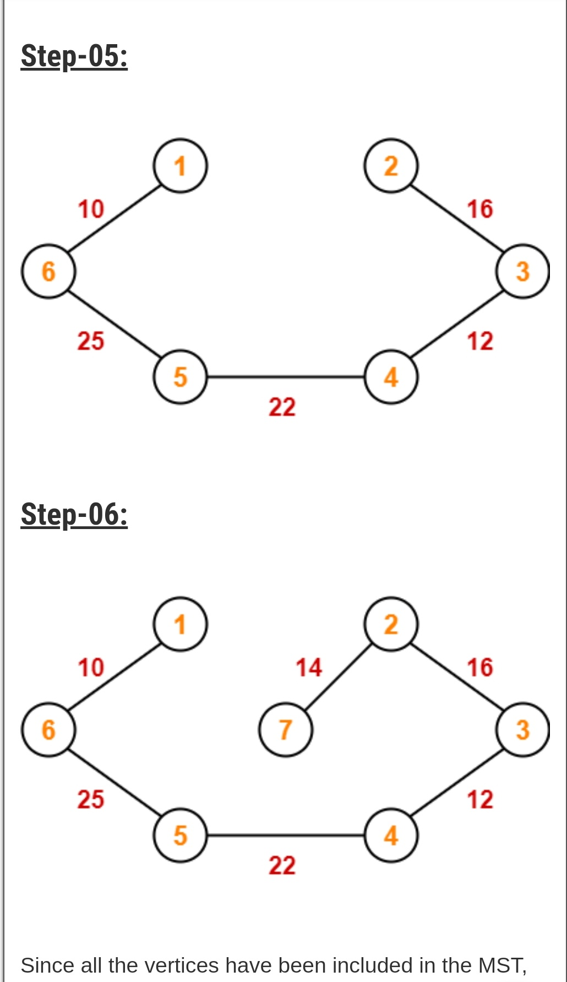

Slide 100
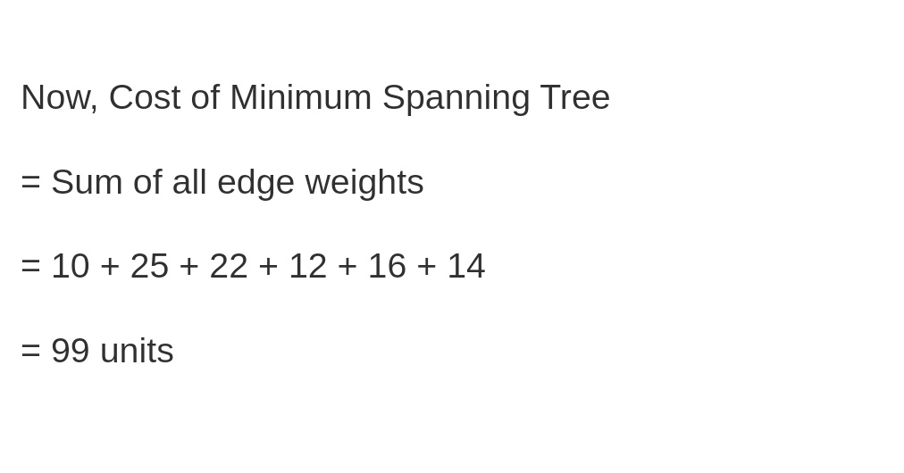

Slide 101
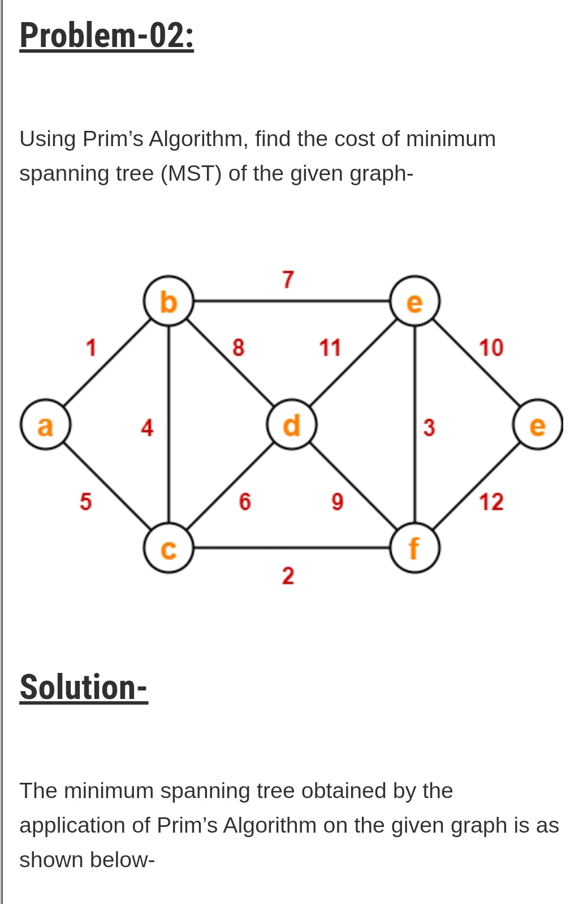

Slide 102
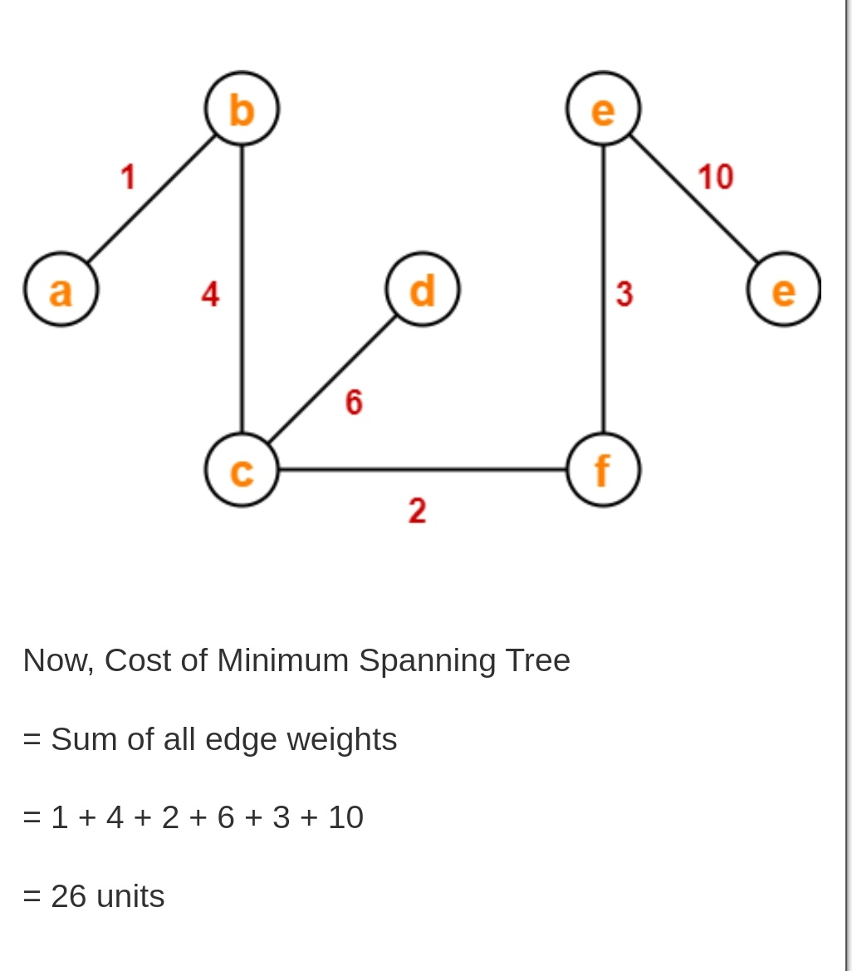

Slide 103
Prim’s Algorithm
1 Algorithm Prim(E, cost, n, t)
2 // E is the set of edges in G.
//cost[1:n,1:n] is the cost matrix such that cost[i,j] is either
4 // positive real number or ∞ if no edge (i,j) exists. cost[i,j]=0, if i=j.
5 // A minimum spanning tree is computed and stored
6 // as a set of edges in the array t[1:n-1,1:2]
7 {
8 Let (k,l) be an edge of minimum cost in E
9 mincost=cost[k,l];
10 t[1,1]=k; t[1,2]=l;
near[k]=near[l]=0;
12 for i=1 to n do // initialize near
13 if( near[i] ≠0 ) then
14 if( cost[i,k]< cost[i, l] then near[i]=k;
else near[i]= l;

Slide 104
14 for i=2 to n-1 do
15 {
// Find n-1 additional edges for t.
17 Let j be an index such that near[j]≠0 and
cost[j,near[j]] is minimum;
19 t[i,1]=j; t[i,2]=near[j];
20 mincost=mincost+cost[j,near[j]];
near[j]=0;
22 for k=1 to n do // update near[]
23 if( ( near[k] ≠0 ) and (cost[k,near[k]>cost[k,j])) then
24 near[k]=j;
25 }
26 return mincost;
27 }

Slide 105
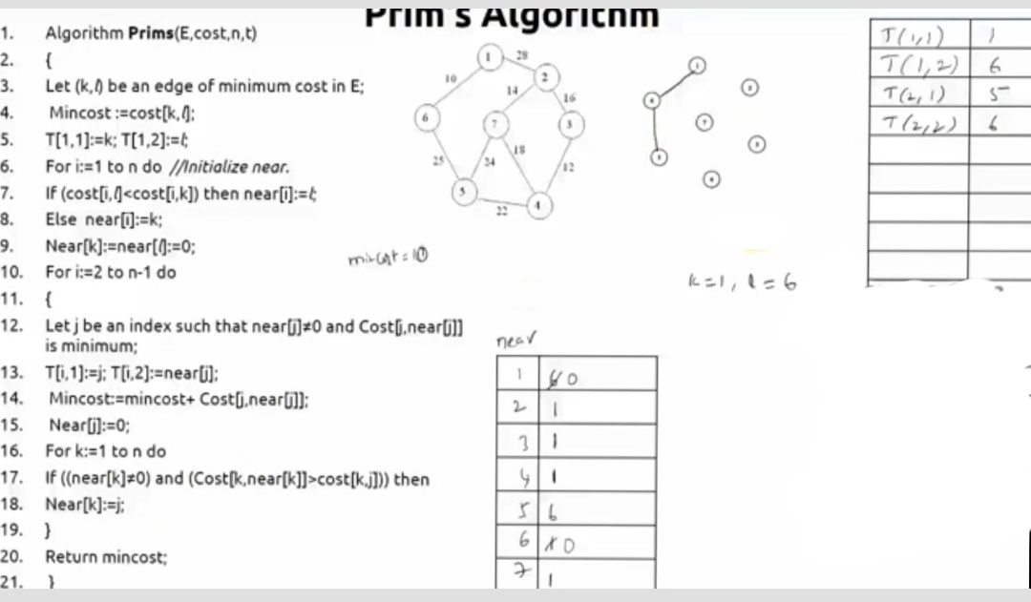

Slide 106
Spanning Tree
T(1,1) | 1
T(1,2) | 6
T(2,1) | 5
T(2,2) | 6
T(3,1) | 4
T(3,2) | 5
T(4,1) | 3
T(4,2) | 4
T(5,1) | 2
T(5,2) | 3
T(6,1) | 7

Slide 107
j=2,3,4,5,7
Cost(2,1) = 28
Cost(3,1) = α
Cost(4,1) = α
Cost(5,6) = 25
Cost(7,1) = α

Slide 108
Spanning Tree
T(1,1) | 1
T(1,2) | 6
T(2,1) | 5
T(2,2) | 6
T(3,1) | 4
T(3,2) | 5
T(4,1) | 3
T(4,2) | 4
T(5,1) | 2
T(5,2) | 3
T(6,1) | 7

Slide 109
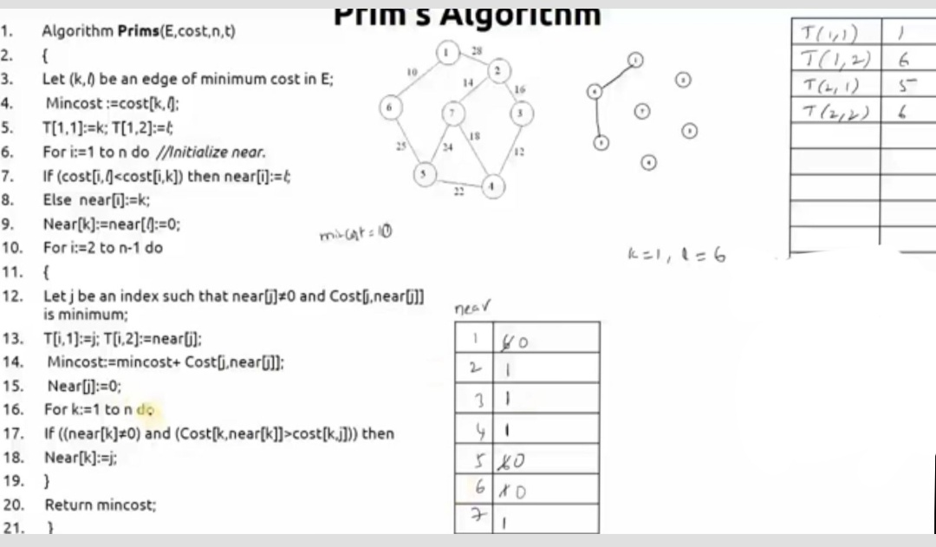

Slide 110
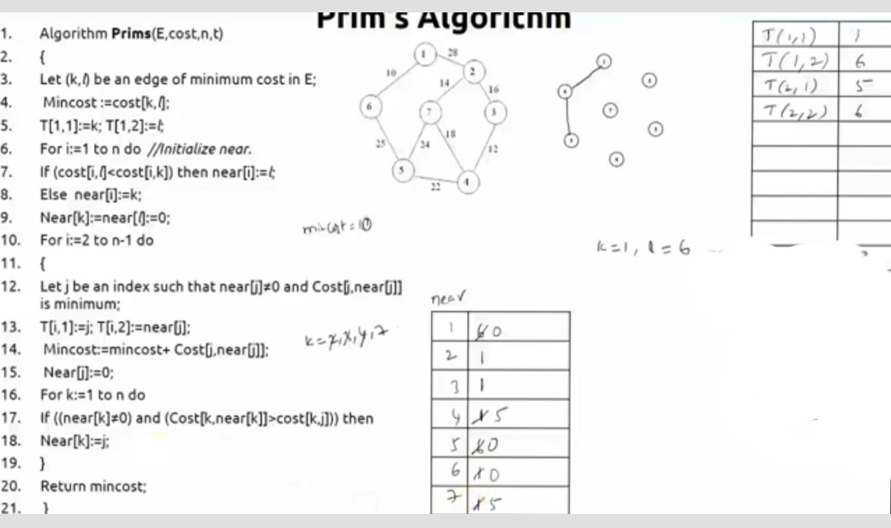

Slide 111
j=2,3,4,7
Cost(2,1) = 28
Cost(3,1) = α
Cost(4,5) = 22
Cost(7,5) = 24

Slide 112
Spanning Tree
T(1,1) | 1
T(1,2) | 6
T(2,1) | 5
T(2,2) | 6
T(3,1) | 4
T(3,2) | 5
T(4,1) | 3
T(4,2) | 4
T(5,1) | 2
T(5,2) | 3
T(6,1) | 7

Slide 113
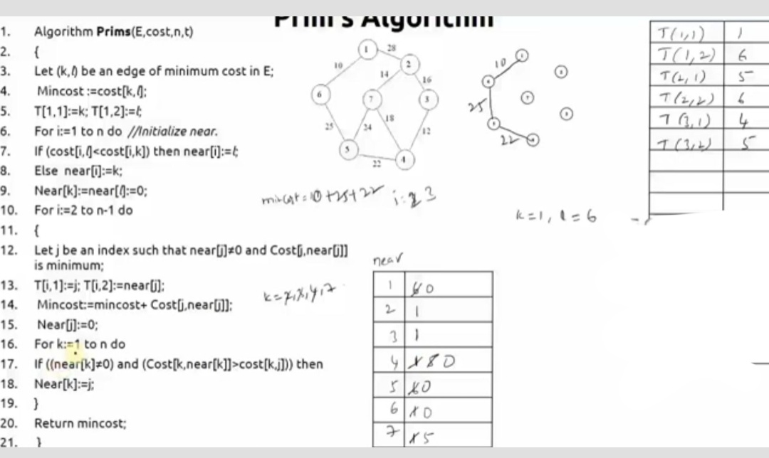

Slide 114
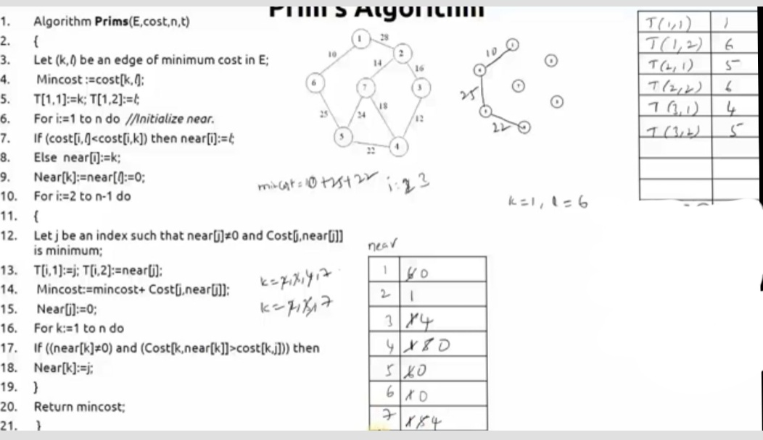

Slide 115
j=2,3,7
Cost(2,1) = 28
Cost(3,4) = 12
Cost(7,4) = 18

Slide 116
Spanning Tree
T(1,1) | 1
T(1,2) | 6
T(2,1) | 5
T(2,2) | 6
T(3,1) | 4
T(3,2) | 5
T(4,1) | 3
T(4,2) | 4
T(5,1) | 2
T(5,2) | 3
T(6,1) | 7

Slide 117
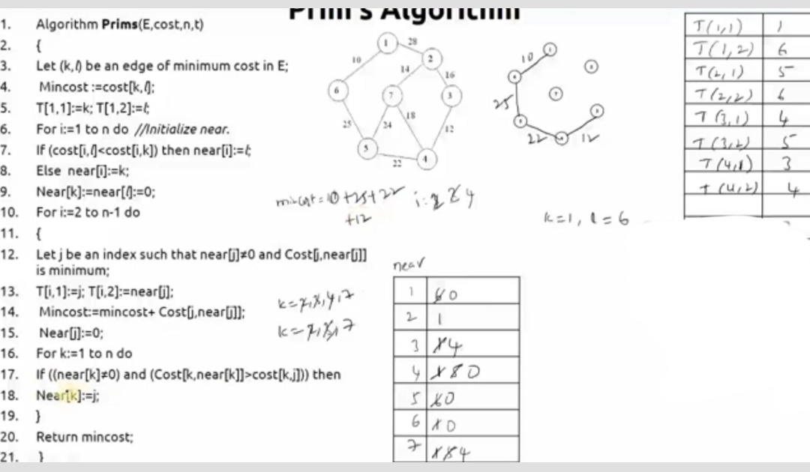

Slide 118
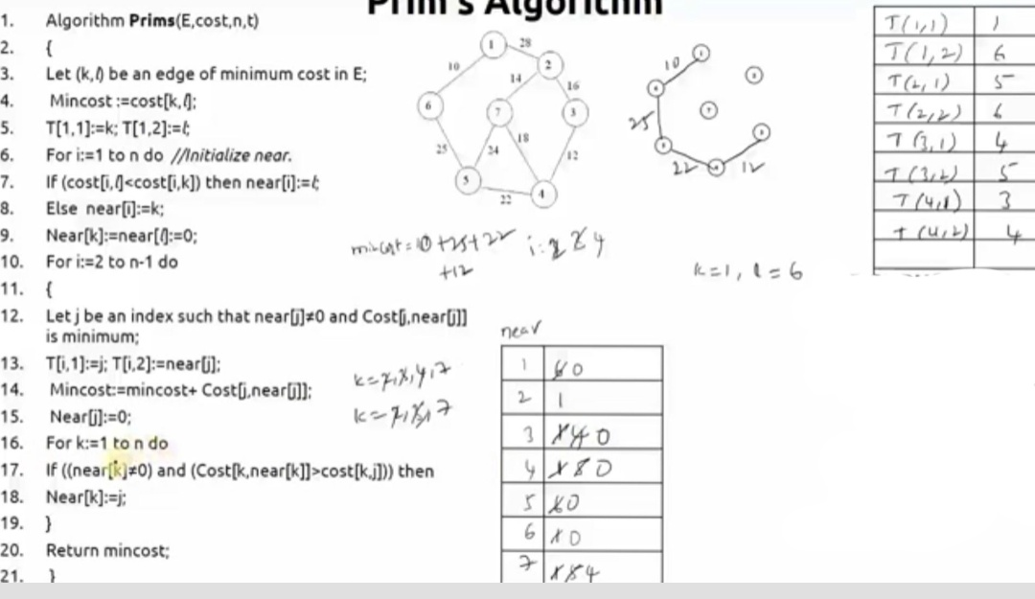

Slide 119
j=2,7
Cost(2,3) = 16
Cost(7,4) = 18

Slide 120
Spanning Tree
T(1,1) | 1
T(1,2) | 6
T(2,1) | 5
T(2,2) | 6
T(3,1) | 4
T(3,2) | 5
T(4,1) | 3
T(4,2) | 4
T(5,1) | 2
T(5,2) | 3
T(6,1) | 7

Slide 121
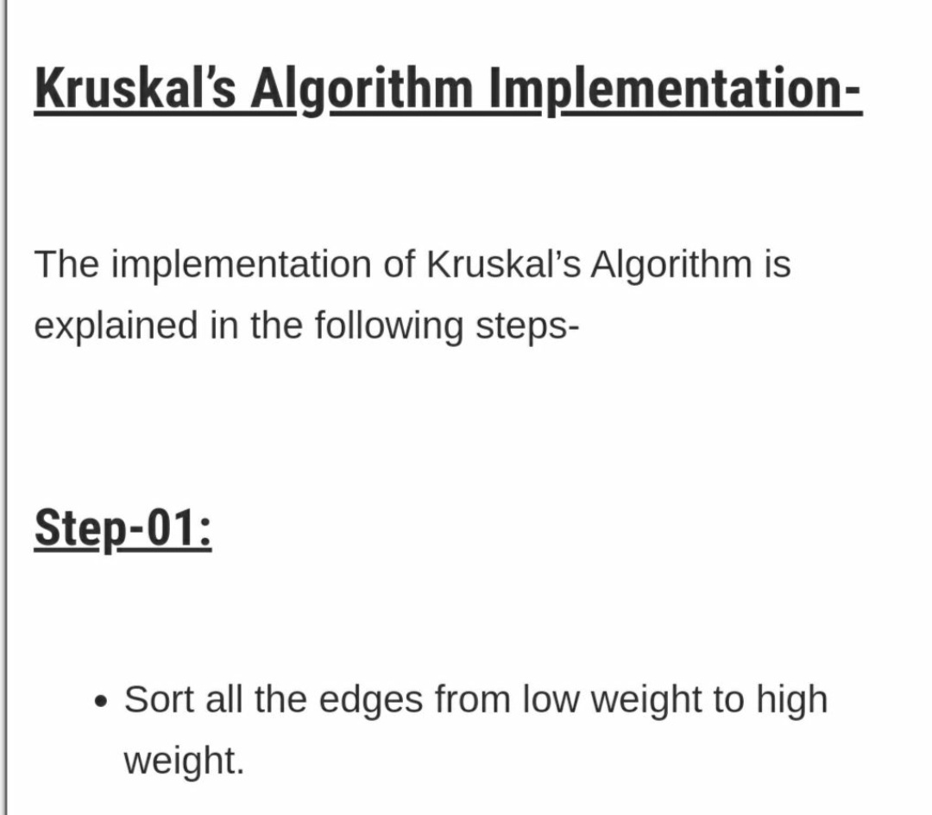

Slide 122


Slide 123
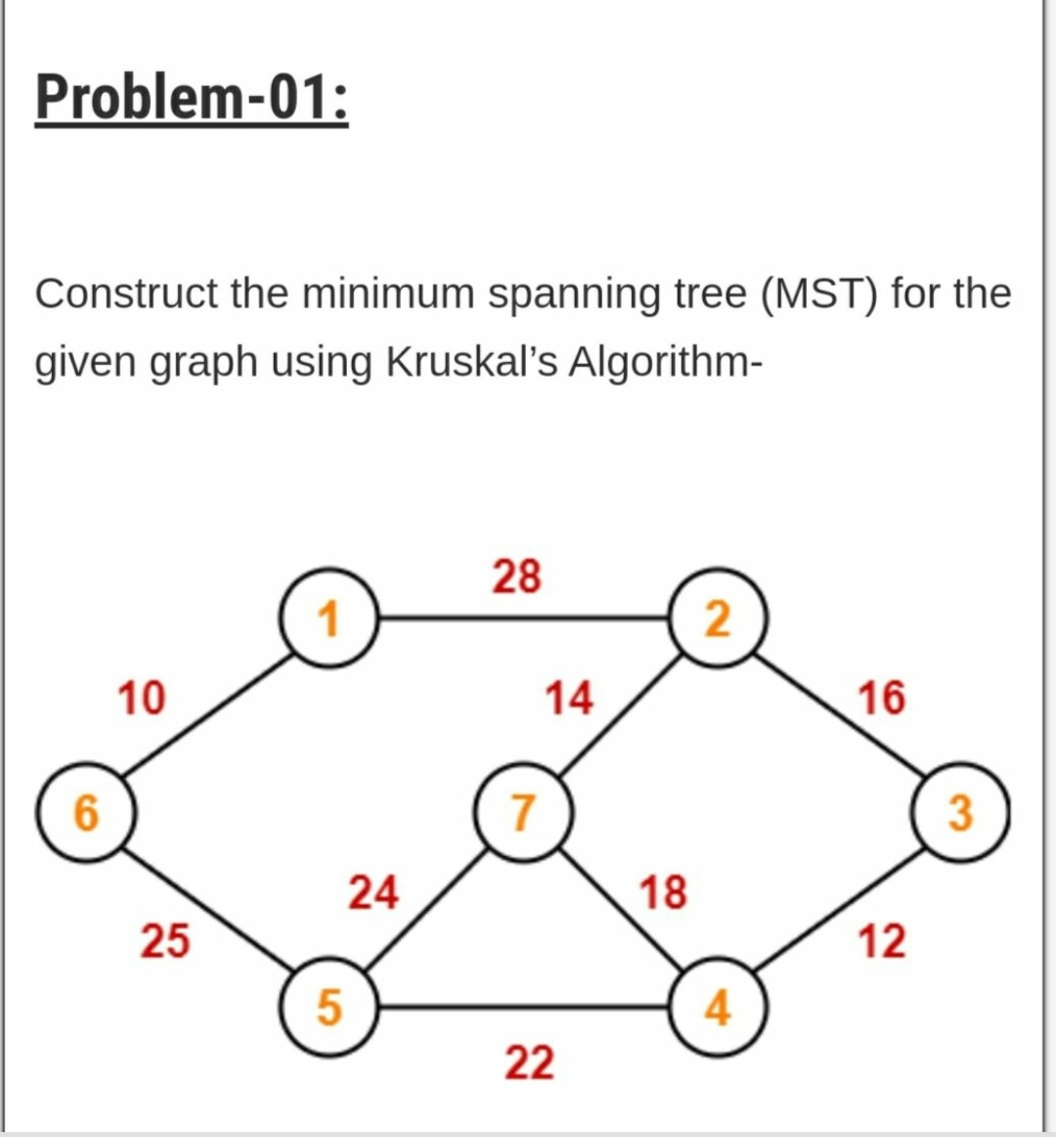

Slide 124
Edge Set E(G)
Edge Weight
1-6 10
3-4 12
2-7 14
2-3 16
4-7 18
4-5 22
5-7 24
5-6 25
1-2 28

Slide 125


Slide 126


Slide 127


Slide 128


Slide 129
MST-Kruskal’s Algorithm
Algorithm kruskal(E,cost,n,t)
// E is the set of edges in G.
//cost[1:n,1:n] is the cost matrix such that cost[i,j] is either
// positive real number or ∞ if no edge (i,j) exists. cost[i,j]=0, if i=j.
// A minimum spanning tree is computed and stored
// as a set of edges in the array t[1:n-1,1:2].
{
for i:=1 to n do
Make-Set(i); // each vertex is in a different set.
Sort the edges of E into increasing order by cost.

Slide 130
mincost:=0; i:=1;
for each edge (u,v) € E, taken in increasing order by cost do
{ j:= Find-Set(u); k:= Find-Set(v)
if( j≠k ) then
{
t[i,1]:=u; t[i,2]:=v;
mincost:=mincost+cost[u,v];
Union(j,k);
i:=i+1;
}
return mincost;
}

Slide 131
Time Complexity of Prim’s = O(n²)
Time Complexity of Kruskal’s = O(n²)
= O(nlogn)

Slide 132
Time complexity of kruskal’s algorithm
With an efficient Find-set and union algorithms, the running time of kruskal’s algorithm will be dominated by the time needed for sorting the edge costs of a given graph.
Hence, with an efficient sorting algorithm( merge sort ), the complexity of kruskal’s algorithm is
o( ElogE).

Slide 133

The Single-Source Shortest path Problem ( SSSP)
Given a positively weighted directed graph G with a source vertex v, find the shortest paths from v to all other vertices in the graph.
Ex :-
v
V₁
V₂
V₅
V₁V₃
V₁V₃V₄
V₁V₃V₄V₂
V₃
V₄
V₆
V₁V₅
5) V₁V₃V₄V₆ 28

Slide 134
1 Algorithm ShortestPaths(v,cost,dist,n)
2 //dist[j], 1≤ j≤ n, is the length of the shortest path
3 //from vertex v to vertex j in a digraph G with n vertices.
4 // dist[v] is set to zero. G is represented by its cost adjacency
5 // matrix cost[1:n, 1;n].
6 {
7 for i:= 1 to n do
8 { // Initialize S.
9 s[i]:=false; dist[i]:=cost[v,i];
10 }
11 s[v]:=true; dist[v]:=0.0; // put v in S.

Slide 135
12 for num:=2 to n do
13 {
14 // Determine n-1 paths from v.
15 Choose u from among those vertices not in S such that dist[u] is minimum;
17 s[u]:=true; // Put u in S.
18 for ( each w adjacent to u with s[w]= false) do
19 // update distance
20 if( dist[w]>dist[u]+cost[u,w]) ) then
21 dist[w]:=dist[u]+cost[u,w];
22 }
23 }

Slide 136
Algorithm Implementation
V = {1,2,3,4,5,6} S={1}
i = 2,3,4,5,6
d[2] = c[1,2] = 50
d[3] = c[1,3] =10
d[4] = c[1,4] = α
d[5] = c[1,5] = 45
d[6] = c[1,6] = α
Path | Length
1→2
1→3 | 10
1→4
1→5
1→6

Slide 137
Algorithm Implementation
i = 1, w = 2,3,4,5,6
S={1,3} V = {2,4,5,6}
d[2] = min{ d[2], d[3]+c[3,2]}
= min{50, 10+ α} = 50
d[4] = min{ d[4], d[3]+c[3,4]}
= min{α, 10+ 15} = 25
d[5] = min{ d[5], d[3]+c[3,5]}
= min{45, 10+ α} = 45
d[6] = min{ d[6], d[3]+c[3,6]}
= min{α, 10+ α} = α
Path | Length
1→2
1→3 | 10
1→4 | 25
1→5
1→6

Slide 138
Algorithm Implementation
i = 2, w = 2,4,5,6
S={1,3,4} V = {2,5,6}
d[2] = min{ d[2], d[4]+c[4,2]}
= min{50, 25+20} = 45
d[5] = min{ d[5], d[4]+c[4,5]}
= min{45, 25+ 35} = 45
d[6] = min{ d[6], d[4]+c[4,6]}
= min{α, 25+ α} = α
Path | Length
1→2 | 45
1→3 | 10
1→4 | 25
1→5
1→6

Slide 139
Algorithm Implementation
i = 3, w = 2,5,6
S={1,3,4,2} V = {5,6}
d[5] = min{ d[5], d[2]+c[2,5]}
= min{45, 45+ 10} = 45
d[6] = min{ d[6], d[2]+c[2,6]}
= min{α, 45+ α} = α
Path | Length
1→2 | 45
1→3 | 10
1→4 | 25
1→5 | 45
1→6

Slide 140
Algorithm Implementation
i = 4, w = 5,6
S={1,3,4,2,5} V = {6}
d[6] = min{ d[6], d[5]+c[5,6]}
= min{α, 45+ α} = α
Path | Length
1→2 | 45
1→3 | 10
1→4 | 25
1→5 | 45
1→6 | α

Slide 141
Time complexity of Dijkstra’s Algorithm
The for loop of line 7 takes o(n).
The for loop of line 12 takes o(n).
Each execution of this loop requires o(n) time at lines 15 and 18.
So the total time for this loop is o(n²).
Therefore, total time taken by this algorithm is o(n²).

Slide 142
Optimal Storage on Tapes How to store Data in Magnetic Tapes and how to Retrieve the data by minimizing the Mean Time to Retrieval.

Slide 143


Slide 144


Slide 145


